Slide 1

USACE-Fort Worth District
The Office of
Small Business Programs
PRESENTER:
Carolyn L. Staten
Deputy, Office of Small Business Programs

Slide 2

USACE Fort Worth Mission
"The U.S. Army Corps of Engineers is a worldwide organization that provides engineering services, environmental restoration, and construction support for a wide variety of civil and military projects. The Corps' primary civil mission is developing and managing the nation's water resources."
Notes:
We support approximately 24 rivers and lakes, 17 Armed Forces and other customers that may require our support example the VA and DLA organizations
The Corps develops projects to reduce flood damage; improves navigation channels and harbors; protects wetlands; and preserves, safeguards, and enhances the environment. The Corps' primary military mission is providing the United States armed forces with modern facilities, at home and abroad; strengthening the nation's defensive capability; and ensuring combat readiness.
Additional missions of the Corps include procurement, planning, design, environmental, real estate, contract administration, real property inventory and assessment services to build and improve various facilities and infrastructure for the Department of Homeland Security and multiple other federal agencies. We also support emergency operations and recovery; and provide recreation opportunities with our 25 lakes."

Slide 3
USACE FORT WORTH DISTRICT FY 16 Achievements & FY 17
Recommended Goal By Percentages
SET ASIDES | Statutory Goals | FY16 Goal % | SWF’s FY16 % Achievements | FY17 Recommended
SB | 23.00% | 54.08 | 52.04 | 54%
SDB | 5.00% | 41.52 | 28.54 | 15%
WOSB | 3.00% | 8.00 | 13.89 | 12%
SDVOSB | 5.00% | 10.00 | 7.00 | 10%
HUBZone | 3.00% | 10.00 | 8.95 | 10%
Notes:
In FY 2015, I received a DOD Small Business Professional award for new interventions as well as support to the small business community. Last year SWF awarded $344 Million with Galveston $431 Million estimated at small business. We estimate project set aside for small business to be around 408 Million. We are in need of the HUB Zone, WOSB and SDVOSB. We met the WOSB and SDVOSB goals. So come out and speak with us.

Slide 4
FY 17/18
Planned Opportunities
USACE Fort Worth District
Project Title / Project Description | Project Location (specific) | Type of Work | Estimated Award | Set-Aside Category | Anticipated Award Date
MCASI Master Planning Support EPAS MATOC | Iwakuni Marine Air Station Japan | OTHCONSVC | $1-5MIL | SB / Small Business | TBD 2017
Hood DPW JOC with 2 Option Years | Fort Hood, Texas | CONSTSVCS | $10-25MIL | SV / Service Disabled Veteran Owned Small Business | 2/2/2017
JBSA B-200 Elec Upgrade | Joint Base San Antonio, Texas | CONSTSVCS | $5-10MIL | SB / Small Business | 3/31/2017
CCAD Hangar 8 Repairs | Corpus Christi Army Depot, Texas | CONSTSVCS | $5-10MIL | SB / Small Business | 5/4/2017
CAP 068826 Simulations Center | Fort Hood, Texas | CONSTSVCS | $25-100MIL | Unrestricted | 5/23/2017
Notes:
Here are some of the Planned opportunities for Fort Worth District

Slide 5
FY 17/18
Planned Opportunities
USACE Forth Worth District
Project Title / Project Description | Project Location (specific) | Type of Work | Estimated Award | Set-Aside Category | Anticipated Award Date
Hood 9400 Block Hammerhead Barracks and CEP | Fort Hood+B603:B702 Texas | CONSTSVCS | $25-100MIL | Unrestricted | 7/21/2017
CAP 076558 Hospital Replacement, Incr 4 Parking Lot | Fort Bliss Texas | CONSTSVCS | $5-10MIL | SB / Small Business | 9/25/2017
VA NCA Ft. Sam Houston Nat'l Cemetery Expansion | Fort Sam Houston | CONSTSVCS | $5-10MIL | SV / Service Disabled Veteran Owned Small Business | 10/22/2017
CAP 077293 Hospital Replacement, Parking Lot | Fort Bliss, TX | CONSTSVCS | $10-25MIL | SB / Small Business | 12/26/2017
CAP 072843 Battalion Complex | Fort Hood+B603:B702, TEXAS | CONSTSVCS | $25-100MIL | Unrestricted | 7/21/2017+I603:I702
Notes:
Here are more of Fort Worth project opportunities

Slide 6
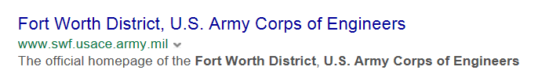
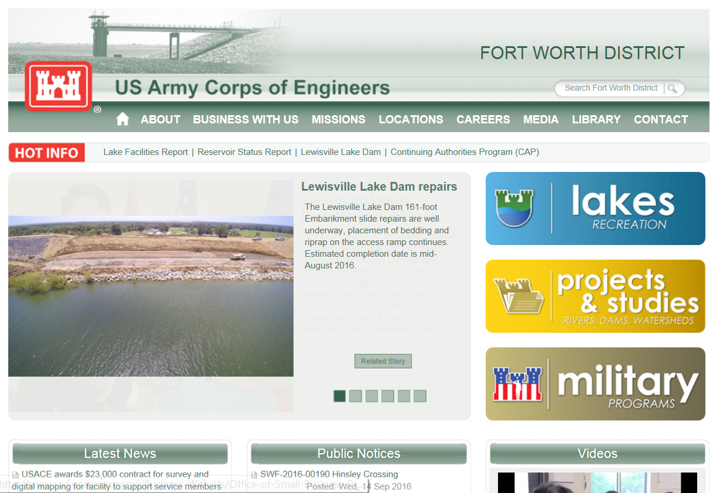
CLICK ON THIS SITE
Notes:
After selecting the right USACE office where does it take me? To the Districts Home page. How do I find the SB office? By placing your mouse over the Business With Us area or tab and CLICK!!! You can find these sites much easier if you remember that there is always a www and a USACE.army.mil. What you must know is the abbreviation of each of the District names. So it is much easier if you just spell out what you are searching for and stick to that. Place your mouse over the Business with Us.

Slide 7
Get a list of all Small Business Professionals
Visit Department of Defense Installations
A listing of all Small Business Professionals
  Selling to the Army - http://sellingtoarmy.com/User/Misc/SearchASBS.aspx
  Selling to the Air Force - http://safsbadmin.mysite4now.net/Locator/LocatorMap.aspx
  Selling to the Navy –http://www.donhq.navy.mil/OSBP/about/sbs-state.html
Notes:
7
7
Remember that small business professionals are better know as the Gatekeepers. You may also seek assistance from your local resource partners. Some examples are, SBA, Procurement Technical Centers, Small Business Development Centers etc.

Slide 8
Key Small Business Contacts
Division Leader, Office of Small Business Programs
Melea Crouse
Melea.crouse@usace.army.mil
District Small Business Professionals
Carolyn Staten – Fort Worth Ken Adams – Galveston
Ceswfddsa@usace.army.mil Kenneth.w.adams@usace.army.mil
(817) 886-1382 (409) 766-3006
Soila Reando – Little Rock Gene Snyman – Tulsa
Soila.t.reando@usace.army.mil Gene.snyman@usace.army.mil
(501) 324-7194 (918) 669-7010
Notes:
Here are the best small business specialists in all of USACE District and their contact information.
Introduce our Small Business Specialists:
For Division….Melea Crouse
Ft. Worth…Carolyn Staten
Galveston…Ken Adams
Little Rock…Soila Reando
And Tulsa…Gene Snyman
Each specialist is here to assist you…please seek them out during any conference that they are available. SWF Deputy is here to speak with you.

Slide 9
QUESTIONS?
Notes:
9
9
QUESTIONS…

