Slide 1

Programs & Opportunities:
Fort Worth District
Society of American Military Engineers
Fort Worth Post
03 November 2014
LTC Neil Craig
Deputy Commander
Fort Worth District

Slide 2
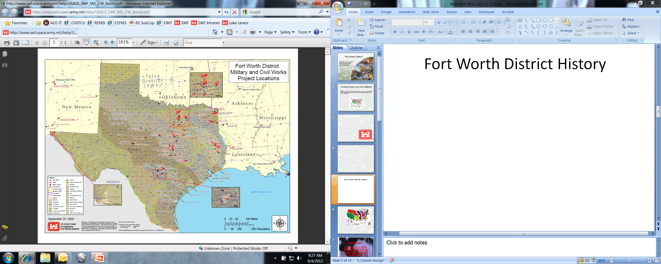
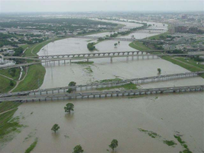
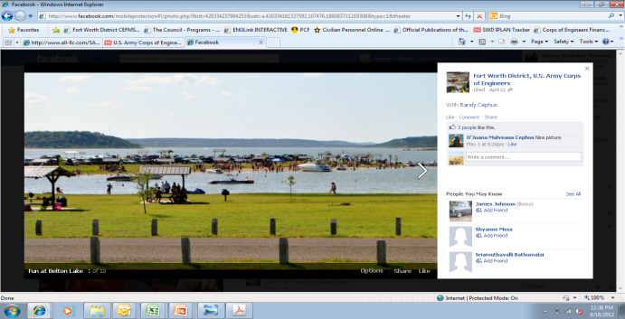
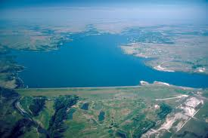
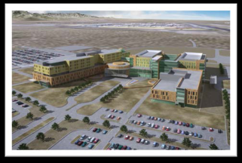
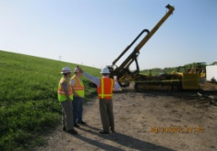
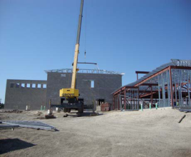
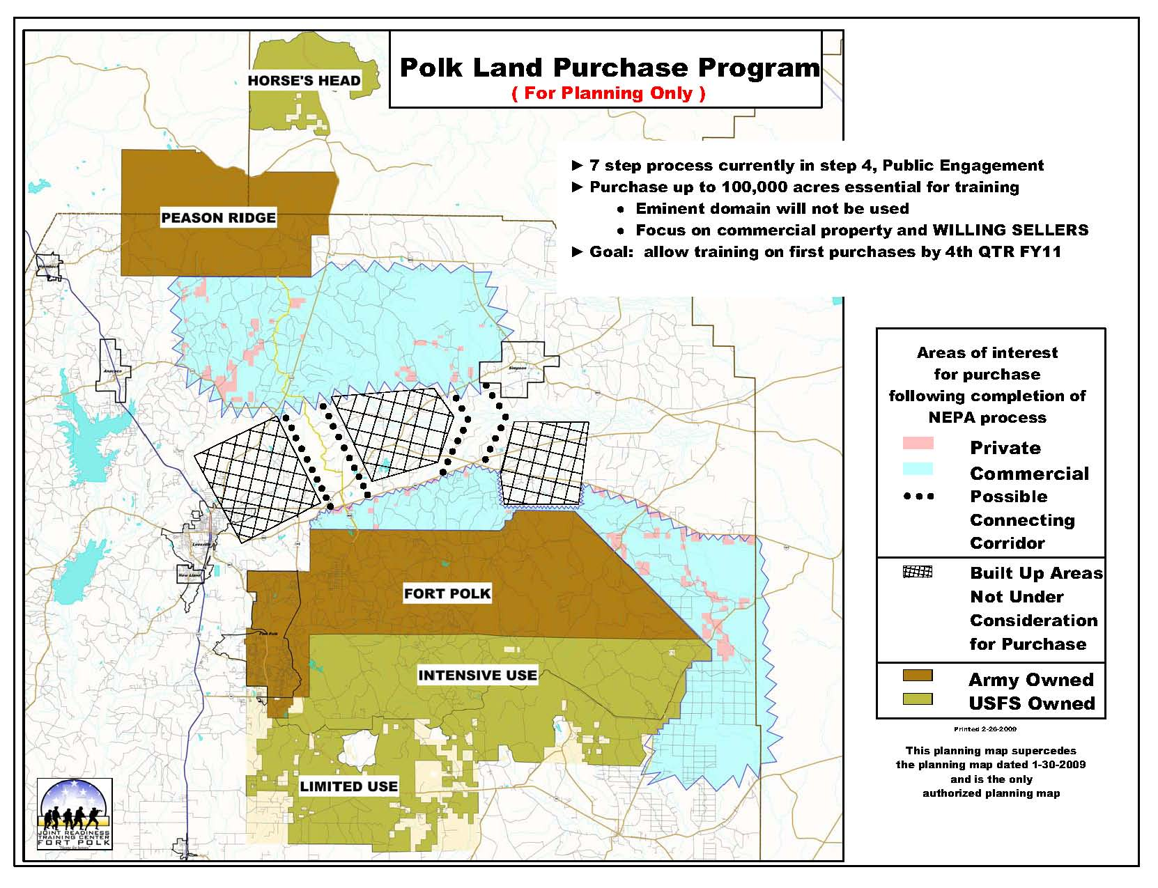
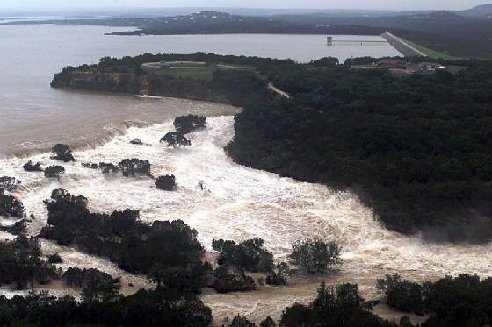
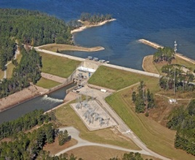
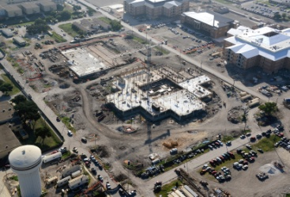
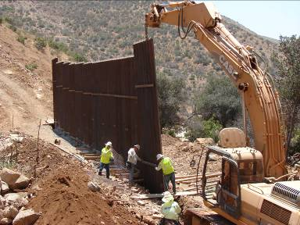
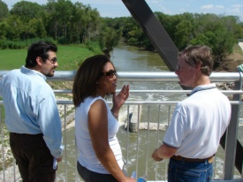
Fort Worth District Mission Areas
Flood Protection
Recreation
Military Construction
(Medical)
Water Supply
Core Drilling
Military Construction
(Army)
Land Acquisition
930 Miles
15 hrs
Disaster Response
Military Construction
(Air Force)
Interagency and International Support
Hydropower Generation
Environmental
Restoration/ FUDs
Notes:
Recreation (69 Park Rangers)
25 multipurpose projects Divided into four (4) regions (Trinity, Piney Woods, Capital and Three Rivers Regions
Manage 314 parks Over 25 million visitors annually
Flood Protection
$2,600,000,000: Dollar Expenditures 40%: Provides Flood Protection to 40% of Texas
10,700,000: Acre-feet of Flood Storage Provide Flood Protection over 10 river basins
Prevented $68Million in Flood damage since 1950
Core Drilling
Fort Worth District has the only Core Drilling TM in USACE
Used to install piezmeters and drilling cores for upcoming projects
Hydro Power (18 employees)
Currently working the DIACAP, will make the Army 31 December requirement
3 hydropower plants (Whitney, Townbluff and Sam Rayborn)
Combined Capacity 90 MW
Sam Rayburn 57.6 MW Capacity Placed into Service 1965
Whitney placed into service in 1953, currently overhauling the two generators at Whitney will bring capacity to 42MW
RD Willis Power Plant (townbluff) 7.4 MW capacity placed into service in 1989
Water Supply
The Fort Worth District’s lakes currently store 1/3 of the available water supply
The demand for water in Texas is expected to increase 22% between 2012 and 2060 to meet a growing population.
2012- 2060 existing water supplies are projected to decrease 10% in resulting in economic losses around $115 billion by 2060 with over a million lost jobs
Fort Worth District is teaming with the Texas Water Development Board on permitting new lakes, and inter-basin pipelines to bring water to where it is needed
Regulatory Division Issued 1,047 Permits and Worked 2,285 Actions in FY12
Disaster Response:
Debris Team three four employees Currently deployed to support Hurricane
Back up for Galveston District in case of Hurricane forces them to evacuate
Team with State of Texas and their regional centers to provide ESF #3 activities
Worked closely with Galveston on Hurricane IKE and with County Judges when Canyon Dam
Real Estate:
Land acquisition at Fort Polk: Closed on the Red River LLC parcel (8,448 acres) on 11 September for a total of 13,368 acres bought this year
Working with Fort Bliss on a land swap with the Local Community College
Manage the Recruiting Station leases
Transferred our HAP program to Savannah earlier this year
MILITARY Program
Military Program Air Force Program
Support 10 Army and 5 Air Force installations Lackland, Randolph, Goodfellow, Laughlin, Dyess ($199M)
Our total MILCON program is worth $.9.9Billion spread from FY 07 to FY 12.
Post Award Construct $2.5B Medical Program
Army $876M BAMC Nutrition - $33m24 Sept 14
Air Force $199M Fort Hood Hospital - $927m 29 Aug 1
Medical $162.4M Fort Bliss Hospital- $954.7M Aug 16
BCA05-$717M Lackland ASC- $476.5m Oct 14
ARRA Medical $562.2M medical Clinic a WSMR- $22.8M May 13
DLA- $2.1M
SRM Program is worth $1.8 Billion
IIS- (Approx $500m)
DLA – $70M Program AFCESA- we have received $81.3 M to date
FY 13: - $33 M CBP - $200m program
FY14:- $33.7 M–
Completed 99 site visits, with another 52 to complete this FY
1,750+ real Property assets inventoried
15,500K sq ft assessed
62 classroom trained FCA assessors

Slide 3
Types of Work
CONSTRUCTION
Design/Build
Levee Repair
Hangars
Medical Facilities
Barracks
ENGINEERING SERVICES
Design
Survey and Mapping
Construction Inspections
Master Planning
Facility Condition Assessments
Energy Assessments
ENVIRONMENTAL SERVICES
Remediation
Studies
Refuse
Investigations
Notes:
SWF provides many opportunities for small businesses in various types of work. For FY 14, we had executed 2,538 construction, construction related, AE services and environmental services actions with total expenditures of nearly $1.5 billion. This included various projects such as tactical equipment maintenance buildings and renovations of various facilities within our footprint.
Specifics - available from our representatives at our booth.
Some examples of projects that were awarded to small businesses in FY 14 were items like….
Construction
Engineering Services
Environmental Services

Slide 4
SWD Military Program (M$ PA)
MILCON workload will dip below pre-’surge’ levels
Majority of the program will be reimbursable
Notes:
4
MILCON’s declining…
Our customer are shifting to sustainment, restoration and modernization
Delivering 3 hospitals at Fort Hood, Lackland and Fort Bliss
As a result of the Army’s Grow the Force, re-stationing, BRAC initiatives and ARRA, our Military Program increased from $0.8B in FY 05 (pre-BRAC) to $3.5B in FY09. The program declined to $1.1B in FY13 and is expected to drop even further in the coming years. Based on current budget projections, the military program is planning to drop to $773M in FY14, $787M in FY15 and $675M in FY16.
SWF is transforming in the Military Missions area. Here are some examples:
* Overall, our Military Construction (MILCON) program is declining (over $2B/yr at the peak and now expect a steady state of ~$400-$500M/yr). Our customers are shifting the focus to Sustainment, Restoration, & Modernization (SRM) as the means to provide facilities that meet mission needs for the DoD.
* Medical MILCON Program. We successfully delivered the San Antonio Military Medical Center (SAMMC) Consolidated Tower and continue to work delivery of three large hospital projects (Lackland, Fort Hood, Fort Bliss). These projects will be incrementally funded over the next several years and comprise a significant part of the annual MILCON program.
* SRM Program. Both the Army and AF are moving towards centrally-managing the large SRM projects. We are working with our customers to execute the designs a year early, so we can achieve timely awards - and avoid the 4th quarter surge that seems to happen each year.
* Environmental/Interagency & International Services (IIS). These programs also are declining, however, the need for environmental services and IIS program delivery remains. Our Fort Worth District is the USACE lead for the Customs and Border Protection (CBP) program and provides the single point of customer interface. We leverage the entire USACE capability by having our Geographic Districts deliver these important homeland security projects. Working with our customers, we are transforming the delivery of our Environmental program through changes in how we manage the
* Small Business remains an essential part of our toolkit as we respond to our Military Missions requirements. The shift to smaller SRM projects brings with it great opportunity. We are looking for partners that will deliver quality projects - on-time and within budget.

Slide 5
SWD Civil Works Program
American Recovery & Reinvestment Act
Flood Control & Coastal Emergencies
Trend:
Operations & Maintenance holding steady
Construction, General increasing slightly
Regulatory holding steady
General Investigations small, but steady
Supplemental Funding
Regulatory
Operations & Maintenance
Continuing Authorities Program
Construction, General
General Investigations
Notes:
No surprise, CW trend is down
- While the CW trend is down of the next few years, the near-term trend for likely SB contracts remains constant when compared to previous years. This is due to the constant O&M funding levels at USACE reservoirs within the region and continued support to the Continuing Authorities Program (CAP). For Fort Worth District, the uptick in Construction, General is primarily related to the ecosystem restoration project at Onion Creek, and most of those funds are related to buying out affected homeowners.
However, small business contracts remain fairly constant in the areas of O&M
- There will be limited opportunities for new A/E funded work due to the constrained Investigations and Construction Accounts.
SWD Priorities:
Texas Coastal Study
Maintaining a reliable navigation system on the McClellan-Kerr AR River Nav System
A/E – Approx. 51 actions for $5M
Construction – Approx. 145 actions for $218M
Other Construction/Services – Approx. 1,410 actions for $60M

Slide 6
MILCON and SRM Awards: FY02-16
FY15 and FY16 are Projected Award Amounts
Notes:
Specific trends for Fort Worth District:
MILCON was the large dollar program for the District through FY13, it was been surpassed by SRM in FY14 and is projected to continue that trend in FY15
The projected increase in MILCON for FY16 is related to having larger projects, in the $25-75 million range, not an increase in projects

Slide 7
FY14 Military Awards
(Contract Amount, 355 projects @ $368M)
By comparison . . . FY13 – 210 projects @$558M
Notes:
A look at our military awards:
In FY 14, awarded 355 actions valued at $368 million . . . 50% more awards than FY13 but for only 66% of the dollar value in FY13
Generally, funds are spread out with Fort Bliss, JBSA, Fort Hood and Fort Polk being the primary locations for spending but opportunities continue to exist throughout Texas . . . RRAD, CCAD, Seagoville, NAS JRB Fort Worth, etc.
Fort Bliss was the largest recipient by dollar amount but this is skewed by the hospital funding increments . . . Remove the hospital and Fort Bliss received roughly the same as Fort Hood and Fort Polk

Slide 8
FY14 Military Awards
Number of Projects, 355 projects @ $368M)
By comparison . . . FY13 – 210 projects @$558M
Notes:
Military awards by number of actions:
Again, 355 awards last year with Fort Hood, Fort Bliss, JBSA and Fort Polk being the epicenters of awards
Fort Hood is higher primarily due to a large number of Job Order Contracts (JOC) awarded

Slide 9
FY13 Awards:
210 Projects @ $558M
FY14 Military Awards
FY14 Awards:
355 Projects @ $368M
By Contract Award Amount
By Contract Award Amount
Notes:
This slide depicts a side by side comparison between FY13 and FY14 looking at the types of military construction awards.
Decrease in MILCON from nearly 75% of the dollars awarded to about 40%
Only 19 MILCON actions awarded out of 355 in FY14
Heavy reliance on JOCs in FY14 . . .

Slide 10
FY14 Military JOC SRM Awards
(187 projects @ $22M)
Number of Projects
Notes:
Given the increased use of JOCs, here’s a break out of the JOC contract awards in FY14
91 actions for $7 million at Fort Hood
48 actions for $3 million at Fort Bliss
20 actions for $7 million at Fort Polk
13 actions for $2 million at CCAD
We will be looking to continue to support our installations with JOC contracts, small businesses should look for these opportunities when JOCs are replaced in FY16 and beyond

Slide 11
FY14 District Expenditures
Type of Funds
Total Expenditures $1,476M
Notes:
A picture of the District’s total expenditures in FY14 . . . we expect FY15 to reflect a similar distribution of expenditures
This also reflects the diversity of programs supported by Fort Worth District
Most of the program is expected to remain in Texas, Louisiana and New Mexico however the DHS and USMC provides opportunities throughout the United States
Still tracking to award new A-E contracts to support ECSO in FY15 – two Unrestricted, one 8(a), two Small Business and one Service Disabled Veteran Owned Small Business . . . Most of the boards have met or are meeting currently
Also in FY15, ECSO has a need for a Repairs and Alteration MATOC. Market research is underway and the acquisition plan is being drafted.
FY16 will see new A-E contracts to support E&C – Unrestricted, HUBZone, SDVOSB, EDWOSB, SB . . . All are primarily military but the two SB tools will be for Civil work. Also in FY16, two construction phased services (Brooks Act) contracts that will be Unrestricted. Our current non-Brooks Act, construction phased services IDIQs will not be replaced

Slide 12
Forecast for Projects
Listing for upcoming projects are posted on our SB web site.
http://www.swf.usace.army.mil/BusinessWithUs/OfficeofSmallBusinessPrograms
Remember all forecast listings are subject to change as awards are being made per quarter.
SWF’s point of Contact for forecast information is Carolyn Staten, Deputy, Office of Small Business Programs at
817-886-1382
Notes:
The list for upcoming projects is available via our sb web site. Or you can get a copy from our SB representative here at the conference.
Listing for upcoming projects are posted on our sb web site and updated every 6 months.
List are subject to changes as awards are made MEANING they will fall off the listing. New Project will be updated each quarter.
SWF is estimated to award $600Mil in FY15.
Beginning in FY 11 through 14 SWF has achieved all our SB goals and are continuously meeting them as of today. We were commended for outstanding support of the Service Disabled Veteran Owned Small Business Program in FY 11 through FY 13 and still awaiting FY 14.
.

Slide 13
FY15 MILCON Opportunities
Fort Worth District
Fort Wingate
Lone Star AAP
White Sands
Missile Range
2
Fort Worth
Red River Army Depot
Dyess AFB
1
Fort Bliss
Longhorn AAP
Louisiana AAP
Goodfellow AFB
Energy Efficient Lighting, Fort Bliss
1st Qtr, $1M-$5M
3-4
Fort Hood
Fort Polk
1
Taxiway Replacement, Dyess AFB
1st Qtr, $25M-$50M
Laughlin AFB
Camp Stanley
2
Dormitory Renovations, Goodfellow AFB
1st Qtr, $5M-$10M
5-6
Camp Bullis
3
Joint Base
San Antonio
Randolph AFB
4
Structural Burn Trainer Facility, Goodfellow AFB
1st Qtr and 3rd Qtr, $1M-$5M ea
Corpus Christi
Army Depot
Fort Sam Houston
5
SAMMC-N Fire Station, JB San Antonio
1st Qtr, $5M-$10M
Lackland AFB
6
FSH Barracks Complex, JB San Antonio
2nd Qtr, $10M-$25M
Notes:
1. Military Construction Program:
FY14 - $663,228,578 (All programs - $804,613,168)
FY15 - $275,447,526 (All programs - $282,637,592)
2. We are already seeing installations providing funding to award some SRM work in 1st Quarter . . . earlier than most years, mostly projects that were lined up, maybe even negotiated at end of FY14 but funds were not available
3. The Fort Worth District manages one of the largest military construction programs in the Corps and supports customers with design and construction projects at 17 active Army and Air Force installations in Texas, New Mexico and Louisiana. Ft. Worth District is one of eight Centers of Standardization (COS) established by the Director of Military Programs in March 2006. The Fort Worth COS supports: Office of Assistant Chief of Staff for Installation Management (OACSIM), Installation Management Command (IMCOM), the Facilities Design Team (FDT), and the Headquarters, U.S. Army Corps of Engineers’ proponent for our assigned facility types.
The district also assists Army and Air Force Reserve customers in Louisiana and Texas, provides operation and maintenance support to installations in three states, and leases facilities for military recruiting commands

Slide 14
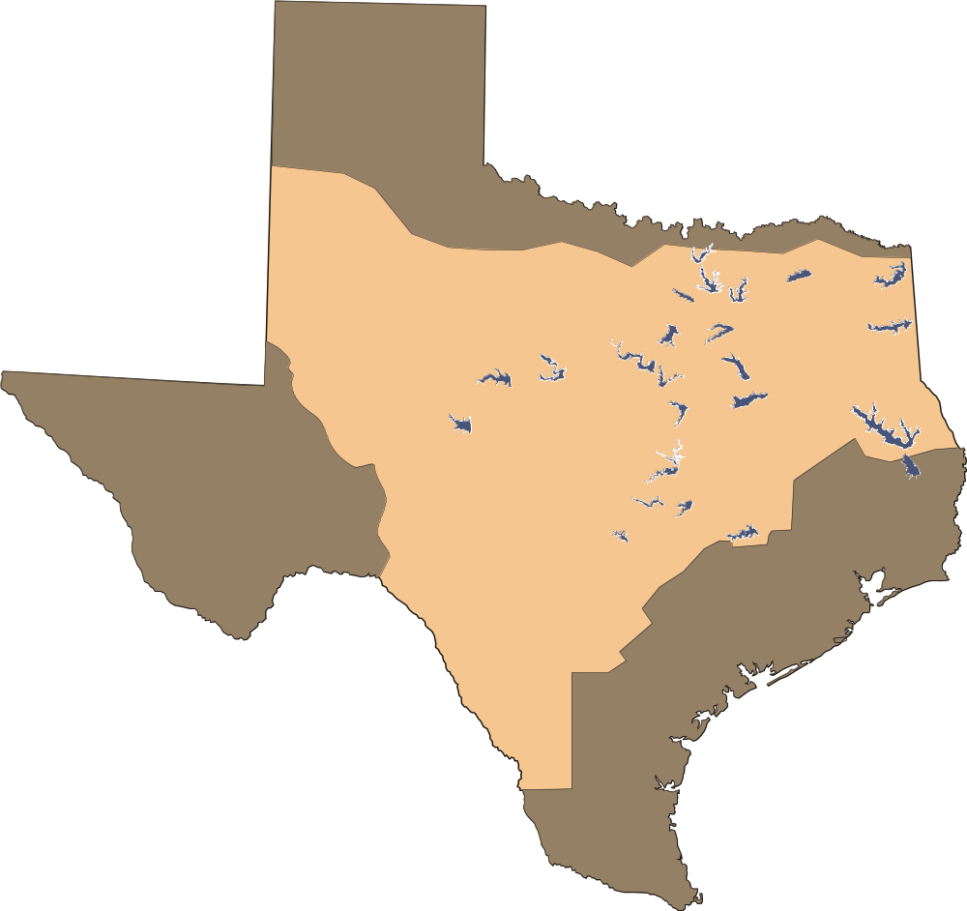
FY15 Civil Works Opportunities
Fort Worth District
Ray Roberts
1-2
Cooper
Lewisville
Lavon
Wright-Patman
Grapevine
Dallas
Fort Worth
Lake O’ The Pines
Proctor
Benbrook
Joe Pool
Hords Creek
3
Bardwell
Whitney
Aquilla
Navarro
Mills
O.C. Fisher
Waco
Sam Rayburn
Stillhouse Hollow
Belton
B.A. Steinhagen
Georgetown
Granger
Canyon
4
Somerville
5
Onion Creek Recreation Project, Design-Build, Travis County, 4th Qtr, $4M-$6M
4
1
Repair Spillway Channel Slopes, Lewisville Dam, 4th Qtr, $300K-$500K
Ecosystem Restoration Project, Walnut
Branch, Seguin, 3rd Qtr - $1M-$5M
5
6
2
Ecosystem Restoration Project, Lewisville/Frisco-2nd Qtr - $1M-$5M
6
Ecosystem Restoration Project,
Rio Grande, Laredo, 3rd Qtr,
$3M-$6M
3
Repair Embankment Seepage Area,
Joe Pool Lake, 4th Qtr, $400K-$600K
Notes:
1. Civil:
FY14 - $41,542,783
FY15 - $ 7,190,066
2. Environmental:
FY14 - $61,020,000
FY15 - $ 0
IIS:
FY14 – $38,821,807
FY15 - $ 0
4. The Ft. Worth District’s civil works area of responsibility covers approximately 53 percent of the state of Texas and portions of 10 river basins from the Rio Grande River in the Southwest to the Red River in the Northeast. The district is collaborating with numerous river authorities, Federal, state and local governments, and resource agencies on water resource studies within the Trinity, San Antonio, Guadalupe, Nueces, Brazos, Sulphur, Rio Grande and Lower Colorado River basins. The issues addressed in these studies range from large, complex, multi-purpose basin-wide water resource problems to smaller localized problems.
The Fort Worth District Civil Works missions include flood damage reduction, ecosystem restoration, water supply, recreation, fish and wildlife mitigation and environmental stewardship. The district’s Operations and Maintenance program includes 25 multi-purpose projects, three hydropower plants, 685,000 acres of land management, 397000 acres of water management and 340 recreation areas which receive over 25 million visitors annually. Our reservoirs have prevented more than $68 billion in flood damages since their construction, while also storing 35 percent of the state’s potable water supply. The district has built 58 flood control and/or multi-purpose projects.
SWF will be setting aside : Ecosystem Restoration Project, Lewisville/Frisco. This project consists of constructing man made wetland cells with control structures, gravel maintenance access paths and native vegetation planting at the project sites along Stewart and Hackberry Creeks at Lewisville Lake near the City of Frisco, TX.
Convert Evaporation Ponds to Conventional Disposal Methods Georgetown, announcement to be issued in 2nd quarter. This project is anticipated to be set-aside for small business
Cultural Resources Survey, Wright Patman Dam - announcement to be issued in 2nd quarter. This project is anticipated to be set-aside for small business
Replace Whitney Power House Roof, Whitney Lake Texas, announcement to be issued 2nd quarter. This project is anticipated to be set-aside for small business
Other various projects include facility maintenance, such as grounds maintenance, janitorial and refuse services can be found at the SB table set up booth.

Slide 15
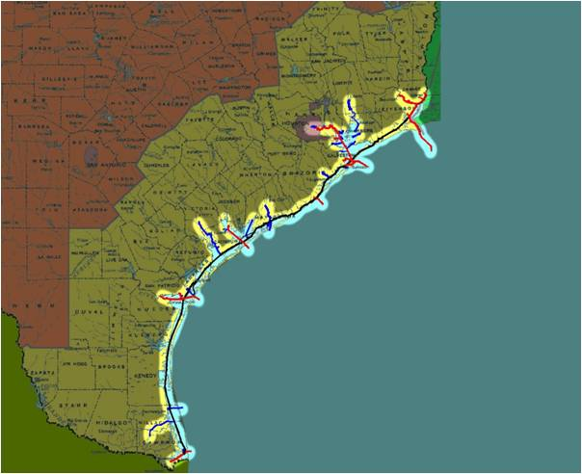
FY15 Opportunities – Galveston District
4
5
2
Galveston District Office
6
1
Falfurrias Checkpoint Relocation - 1st Qtr – SBSA - $10M – $25M
3
2
  Jadwin Building Repairs – 2nd Qtr – SB $100K - $500K
1
  Corpus Christi Residence Office Repairs – 2nd Qtr – SB - $100K - $500K
3
4
Port Arthur Resident Office – 2nd Qtr – SB - $500K - $1M
5
Port Arthur Resident Office - Shoreline Stabilization – 3rd Qtr – SDVOSB - $1M - $5M
6
Gulf Intracoastal Waterway – 3rd Qtr – SB –
$500K - $1M
Notes:
Falfurrias Checkpoint Relocation: This project is construction of a new 4 lane commercial and 4 lane non-commercial Border Patrol Checkpoint over an approximate 1.4 mile site located on Highway 281 to include demo of existing checkpoint. Construction will also include 8 lane primary canopy, 16 secondary inspection lanes with canopy, vehicle lift inspection area, deceleration and acceleration lanes, commercial x-ray area, Government parking, impound lot, administration facility with sallyport (processing, holding area, restrooms, office spaces, security room, data/ phone room), secondary facility with loading dock (evidence storage, restrooms, office spaces, communications room), antenna tower, fueling system (15000 gallon tank), kennel facility, water well (potable, fire protection), and septic system. Furniture and equipment will be provided for all areas as required by the design. Appropriate signage and lighting will be provided in accordance to Texas Department of Transportation and design requirements. Border Patrol security and communications standards will be utilized throughout site layout to include local and remote cameras, network video recorders (NVR), secure access readers (U.S. Government Personnel Identification Verification card readers), radio communication equipment, and data/telephone equipment. $10M - $25M
Jadwin Building Repairs: Work includes replacement of the garage access gates, replacing some exterior site light fixtures, replacing the Jadwin Building exterior mounted lighting, fixing broken boiler controls, Regulatory Division Chief office build out and shifting of 26 cubicles and associated electrical/lan wiring. $100K - $500K
Corpus Christi Residence Office Repairs: The project work is to furnish and install new exterior and interior lighting and other electrical items, furnish and install new Boat Charging Station, parking lot repairs, entrance gate work, interior drainage pipe cleaning and other plumbing repairs, furnish and install kitchen garbage disposal, refurbish shower stall, general garage door maintenance, provide new furniture, refurbish window hinges, relocate ice machine, and demolition and removal of 3 radio towers, with disposal of trash and debris in an approved method. $100K - $500K
Port Arthur Resident Office: Construct a new Resident Office of approximately 2800 gross square feet on Pleasure Island, in the vicinity of Port Arthur, Texas. Building shall consist of brick veneer over a steel frame building structure. The estimated cost range will be between $500K - $1M.
Port Arthur Resident Office (PARO) Stabilization: Contract involves erosion stabilization work along the shoreline in front of the Galveston District, Port Arthur Resident Office. Work will involve the removal and disposal onsite of existing stone revetment along the approximate 700 foot length of shoreline and replace it with steel sheet pile wall. $1M - $5M
Gulf Intracoastal Waterway - FY15 BRFG and CRL Combined Facilities Repair - Proposed contract work will be performed at the Brazos River Flood Gates (BRFG), Freeport, Texas and Colorado River Locks (CRL), Matagorda, Texas. The work will consist of electrical repairs and upgrades at BRFG and CRL and fuel systems and associated piping at the BRFG generator building and boathouse. Electrical repairs and upgrades will include new service meter boxes, feeders and panel boards at BRFG, new site lighting at both locations, and new guide wall lighting at CRL. Estimated range $500K to $1M.

Slide 16
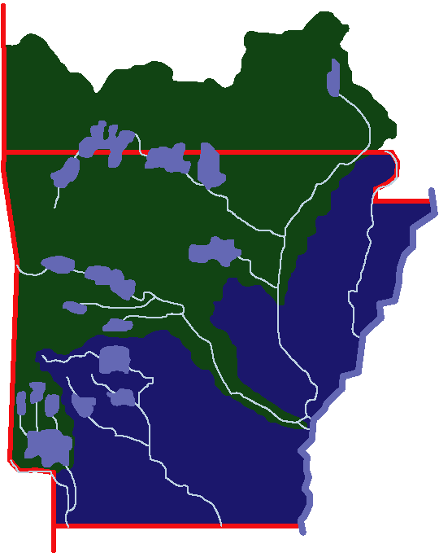
FY15 Opportunities – Little Rock District
Replace Gate Tower Windows, Blue Mountain
(Between $250-500K) 1st Qtr, SB
IDIQ Park Mowing Services, Table Rock Lake (Between $100-250K) 1st Qtr, SB
Geothermal Conversions, Cleawater & Bull Shoals Project Offices (Between $500K-$1M) 1st Qtr, SB
High Water Access to Tainter Gates, Table Rock Dam (Between $250-500K) 3rd Qtr, SB
IDIQ Park Maintenance Services, Greers Ferry Lake (Between $500K-$1M) 2nd Qtr, SB
Initial Outfitting Requirement
US Army Medical Materiel Center, Europe, Kaiserslautern, Germany (Between $10-$25M) 1st Qtr, SB
Integrated Design Build Initial Outfitting MATOC, US Air Force Medical Service Healthcare Facilities Modernization Program, (Over $500M), 2nd Qtr, TBD
1
MO
3
2
2
4
Clearwater
Table Rock
3
Bull Shoals
3
Beaver
Mtn. Home
Norfork
4
5
1
Ozark
Greers Ferry
5
Blue Mtn.
Russellville
Nimrod
Gillham
Little Rock District Office
6
DeQueen
Dierks
Pine Bluff
Millwood
Tri-Lakes
7
Outside Little Rock Boundary
6
7
Notes:
*The Little Rock District has identified key contracts that will support our customers and the small business program.
The Replace Gate Tower Windows which require replacement of steel windows.
Table Rock Mowing is one of several mowing service contracts which are up for re-solicitation for district park areas.
3. Conversion consist of replace Incandescent Lights and Fixtures and HVAC System.
4. High Water Access to Tainter Gates - The particulars for this requirement are still under development.
Greers Ferry Park Maintenance is one of several maintenance service contracts which are up for re-solicitation for district park areas.
The pre-solicitation notice has been posted the solicitation is expected to issue today.
7. Market research is being gathered to determine acquisition strategy.

Slide 17
FY15 Opportunities – Tulsa District
1
$5M & $15M Design-Build Const SATOC (WOSB) – 3rd Qtr
$5M & $15M Design-Build Const SATOC (HZ) – 3rd Qtr
$49.5M Design-Build Const SATOC (SB) – 3rd Qtr
KC 46 Two-Bay Hanger(TAFB)-4th Qtr-$50M-$100M
KC 46 Depot Maint Complex(TAFB) – 4th Qtr – Less than $50M
Gate Closure System (Broken Bow) – 4th Qtr – Less than $500K
Repair 4 Tainter Gates(Copan) – 4th Qtr – Less than $5M
Replace Flood Gate/Rehab Two Emergency Gates(Texoma) – 4th Qtr – Less than $5M
Install Hydro-Turbine Generator(John Redmond) – 4th Qtr – Less than $500K
Seal Leaks in Discharge Conduit(Pay Mayes) – 4th Qtr – Less than $500K
Repair Eight Service Gates(Big Hill) – 4th Qtr – Less than $5M
9
2
3
11
4
7
5
6
5
7
4
5
8
6
9
8
10
10
11
1-3
SWT AOR
Notes:
*The Tulsa District has identified key contracts that will support our customers and the small business program.
The projects listed at Broken Bow, Hugo, Texoma, Robert S. Kerr, Tenkiller, and Wister are part of Tulsa’s FY14 Major Maintenance Program. Statements of work are being prepared now. We expect to precede solicitations with Sources Sought in second quarter to determine Small Business set-aside categories. SWT is looking for specialized experience with hydraulic steel structure repair for these projects.
Canton: Bulkhead is a component of major rehabilitation of Canton Dam. Sources Sought for Bulkhead issued in 2nd quarter.
Altus AFB KC-46 Hanger Dock Extension will require specialized experience with hanger doors. Sources sought will precede solicitation.

Slide 18
FY15 and FY16 Contract Opportunities
Location Value (Capacity) Set-Aside Decision Release Date
SWF AE SVCS (Design) 30.0 Mil ($15 x 2) Unrestricted Mil 2Q, FY15
SWF AE SVCS (Design) 30.0 Mil ($10 x 3) 8(a) Mil 4Q, FY15
SWF AE SVCS (Design) 10.0 Mil ($10 x 1) SDVOSB Mil 3Q, FY15
SWF AE SVCS (Design) 10.0 Mil ($10 x 1) EDWOSB Mil 3Q, FY15
SWF AE SVCS (Design) 5.0 Mil ($ 5 x 1) HubZone Mil 2Q, FY15
SWF AE SVCS (Design) 15.0 Mil ($7.5 x 2) Small Business Civil 2Q, FY15
SWF ECSO Horizontal 40.0 Mil (Target of 5, RGV) 8(a) 3Q, FY16
SWF ECSO Horizontal 70.0 Mil (Target of 5, TX) SDVOSB 1Q, FY16
SWF ECSO Horizontal 30.0 Mil (Target of 5, San Diego) 8(a) 1Q, FY16
SWF ECSO Horizontal 30.0 Mil (Target of 5, Tucson) 8(a) 2Q, FY16
SWF ECSO Horizontal 79.0 Mil (Target of 5, SW Border) UR 2Q, FY16

Slide 19
Fort Worth Small Business Program
FY11-14 Obligation Trend
Notes:
SWF has achieved it small business goals for the last four years . As you can see, we have shown a slight decrease in our total dollars obligated to Small Business, however, we remain steady in the Small, Disadvantaged Business, Women-Owned Small Business and in the Service-Disabled. There was a slight decrease in Hub Zone. The Veteran-Owned Small Business obligations show an increase. The SDVOSB vehicles are in place. Upcoming procurements are in the process this FY. Look for issuance in the 2nd and 3rd quarter.
The absence of Historically Black Colleges-Universities/Minority Institutions obligation is due in part again, to ROTHE vs. DoD, in which we are no longer able to procure using Historically Black Colleges-Universities/Minority Institutions set-asides. However we are inspired to target and meet this aspirational goal this FY.
The Fort Bliss Hospital makes up approximately 40% of our FY 13 MILCON program of the $1.07B MILCON Program.

Slide 20
Fort Worth Small Business Program
FY11-14 Percentage Trend
Notes:
As you can see, the goals are set based on the last three year total obligations and determines the % for each upcoming FY. We met all of our all of our SB goals FY 11-14 which are bolded in black, color purple.
Although the total amount of dollars going to SB is going down, the percentages have steadily increased.
As you can see, we have shown an increase in our Small Business, Women, Historically Underutilized Business Zones, and Service-Disabled Veteran-Owned Categories between FY 11 and FY 12 &13.
The Small, Disadvantaged Business category remains roughly the same.
The decrease in the Historically Black Colleges-Universities/Minority Institutions is due to ROTHE vs. DoD, in which we are no longer able to procure using Historically Black Colleges-Universities/Minority Institutions set-asides.

Slide 21
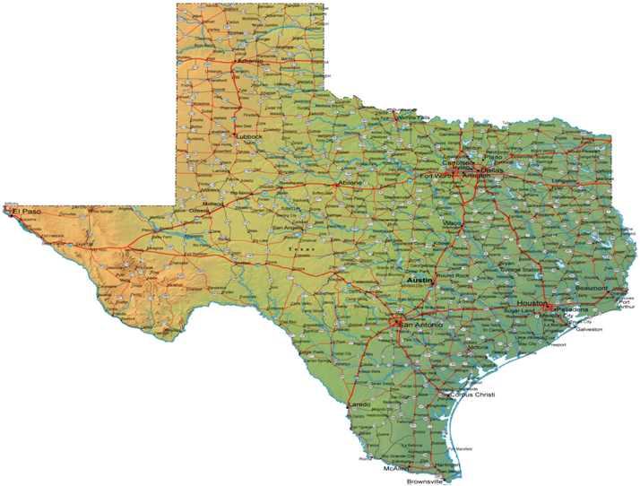
Small Business Dollars at Work in Texas
Dallas/ Fort Worth
FY11 $14M
FY12 $3M
FY13 $46M
FY14 $12M
Fort Bliss
FY11 $59M
FY12 $59M
FY13 $342M
FY14 $6.4M
Central Texas
FY11 $82M
FY12 $133M
FY13 $305M
FY14 $44M
San Antonio
FY11 $19M
FY12 $62M
FY13 $65M
FY14 $39M
For more information on how do business with the Fort Worth District, Corps of Engineers contact
Carolyn Staten 817 886-1382 or email ceswfddsa@usace.army.mil
Notes:
These are some of our major project facilities and an estimate of what was spent FY 11 through FY 14.

Slide 22
Doing Business with Fort Worth
1. Respond to sources sought and requests for information.
2. Attend all events concerning the proposal to make sure you know exactly what's expected - site visit, pre-proposal conference, etc., and read all amendments.
3. Ensure your SAM information is up to date. Visit with a Procurement Technical Assistance Center (PTAC) for SAM and proposal process assistance. Consider multiple small business certifications. Market yourself to the Districts as a SB concern with multiple-certifications and be sure your business cards and capabilities statements prominently reflect your status.
4. Form teaming agreements or subcontracting arrangements with other contractors. Subcontracting work is great for experience and understanding of Corps projects.
Take advantage of feedback via a de-brief with contracting officers following unsuccessful proposals.
Attend monthly and/or a capabilities briefings and demonstrate your companies experience and how you will contribute to our Districts small business programs.
Notes:
1. Respond to sources sought and requests for information. Outside of the Dynamic Small Business Search Engine, SWD utilizes the sources sought method when conducting market research. If you are interested in the work, please respond.
2. Attend all events concerning the proposal to make sure you know exactly what's expected - site visit, pre-proposal conference, etc., and read all amendments. The more you know, the farther you go.
3. Ensure your SAM information is up to date. If you need to visit with a Procurement Technical Assistance Center (PTAC) to be sure you are in the system properly – make that contact. Visit a PTAC first so they can help you with the SAM and proposal process. Consider multiple small business certifications. Market yourself to the Districts as a SB concern with multiple-certifications and be sure your business cards and capabilities statements prominently reflect your status. There is a Resource Partners booth in the exhibit hall consisting of the PTAC, Small Business Development Center and SBA. There are available to assist you in this area.
4. Try to form teaming agreements or subcontracting arrangements with other contractors. Subcontracting work is great stepping stone in receiving prime contract work with the SWD.
Take advantage of feedback with contracting officers following unsuccessful proposals. While we may be limited to what information we can disclose, it is still a great method to learn from and apply those lessons learned to the next proposal or bid.
Attend monthly and/or capabilities briefings and demonstrate your companies best qualities Show us what you have to offer us. We are here to listen and assist with SB programs.

Slide 23
FY15 Items of Interest
SAME Small Business Conference
Kansas City, MO
Date: Dec 9-11, 2014
Small Business Open House and Networking Forum – Fort Worth, TX
Date: Feb 13, 2015
POC: Carolyn Staten - ceswfddsa@usace.army.mil
Arkansas Procurement Small Business Conference – Little Rock, AR
Date: April 2015
POC: Soila Reando – soila.t.reando@usace.army.mil
Notes:
These are the various networking opportunities within our Division that you may want to attend....We hope to see you at these events.
====================================
Additional notes:
These conferences allow you …
To meet with our district deputies for small business programs.
Continually engagement with SWD and networking, whether it is to maintain relationships or create new ones.
To showcase your capabilities, provide future opportunities and training sessions for you.
To assist in increasing our small business industrial base in service to the war fighter
What our Small Business Specialists are doing:
Monitoring Percentage of work going against existing tools
Ensuring a portion of the work is executed outside the existing tools

Slide 24
Key Small Business Contacts
Division Leader, Office of Small Business Programs
Melea Crouse
Melea.crouse@usace.army.mil
District Small Business Specialists
Carolyn Staten – Fort Worth Ken Adams - Galveston
Ceswfddsa@usace.army.mil Kenneth.w.adams@usace.army.mil
(817) 886-1382 (409) 766-3006
Soila Reando – Little Rock Gene Snyman – Tulsa
Soila.t.reando@usace.army.mil Gene.snyman@usace.army.mil
(501) 324-7194 (918) 669-7010
Notes:
Here are the best small business specialists in all of USACE with their contact information.
Introduce our Small Business Specialists:
For Division….Melea Crouse
Ft. Worth…Carolyn Staten
Galveston…Ken Adams
Little Rock…Soila Reando
And Tulsa…Gene Snyman
Each specialist is here to assist you…please seek them out during any conference that they are available. SWF Deputy is here to speak with you.

Slide 25
Key Contracting Contacts
Principal Assistant Responsible for Contracting (PARC)
Denver Heath
Regional Chief of Contracting
David Curry
Chiefs of Contracting
Kathrine Freeman – Fort Worth Curtis Cole - Galveston
Sandra Easter – Little Rock Brian Brobson - Tulsa
Deputy District Engineers
Peggy Grubbs – Fort Worth Edmond Russo - Galveston
Randy Hathaway – Little Rock John Roberts - Tulsa
Notes:
Here is a list of the best contracting and engineering professionals in all of USACE…

Slide 26

Questions?
Facebook:
www.facebook.com/pages/Fort-Worth-District-US-Army-Corps-of-Engineers/18808371129308swdusace
Twitter:
www.twitter.com/#!/usace_FortWorth
Flickr:
www.flickr.com/usaceswd
DVIDS:
www.dvidshub.net/unit/USACE-SWD
Online:
www.swf.usace.army.mil

