Slide 1
TEXAS GULF COAST HURRICANE RESPONSE
Society of American Military Engineers
3 June 2013
Dallas/Fort Worth Post
Anthony “Tony” Semento

Slide 2
AGENDA
Introductions/Admin
Oklahoma Tornado’s
Overview/ Phase 1/2
BREAK
Phase 3/4/5
Contracting
Discussion/Closing Remarks

Slide 3
http://www.youtube.com/watch?v=kOh9Ptz4w28

Slide 4
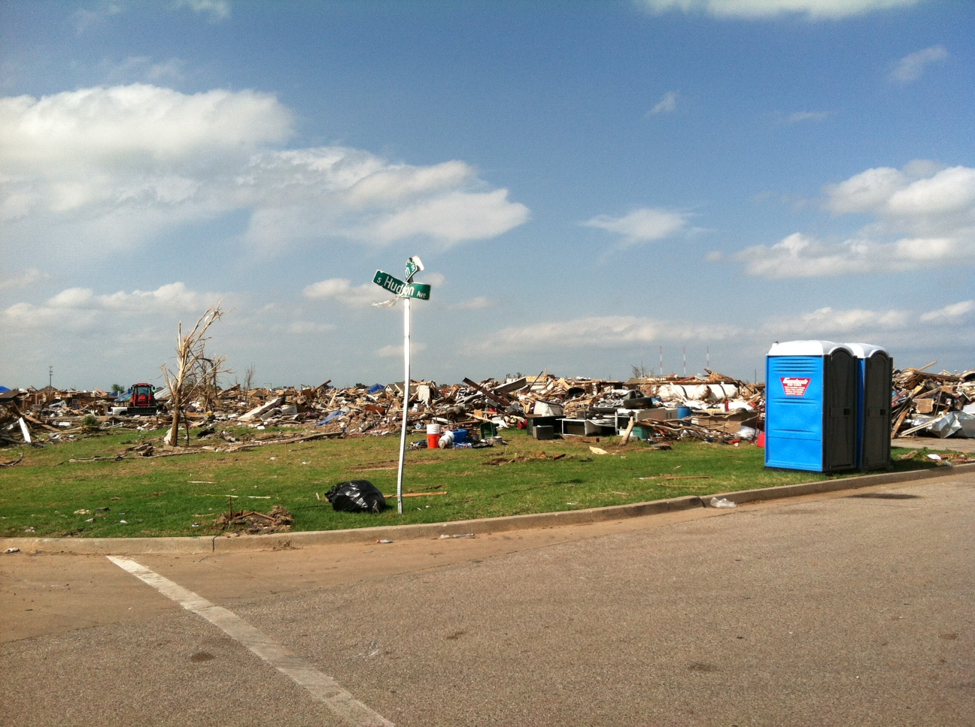
Moore, Oklahoma 31 May

Slide 5
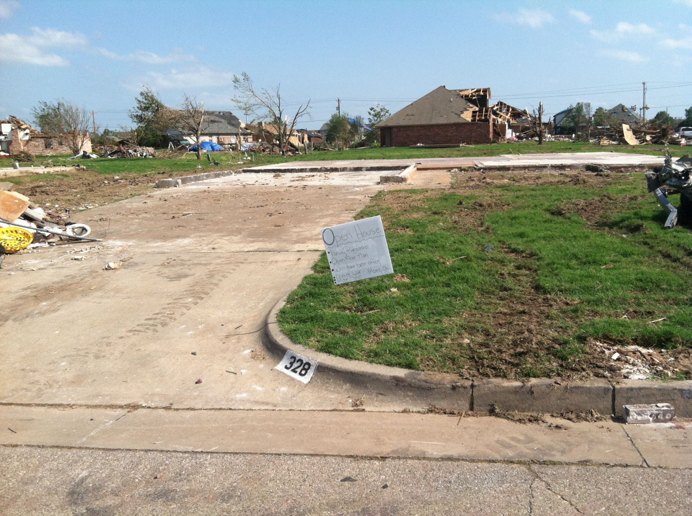
Moore, Oklahoma 31 May

Slide 6
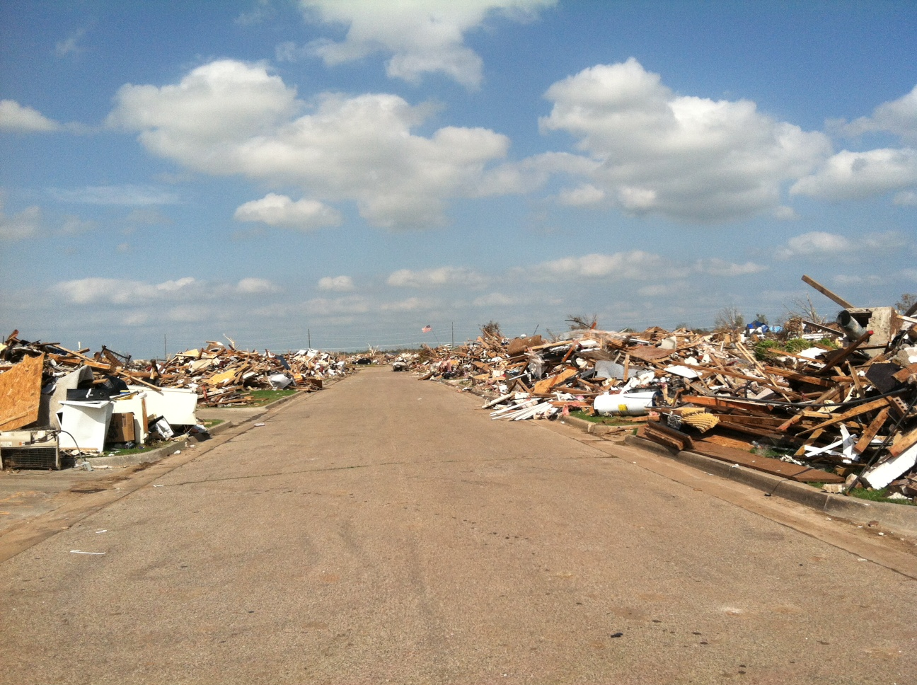
Moore, Oklahoma 31 May

Slide 7
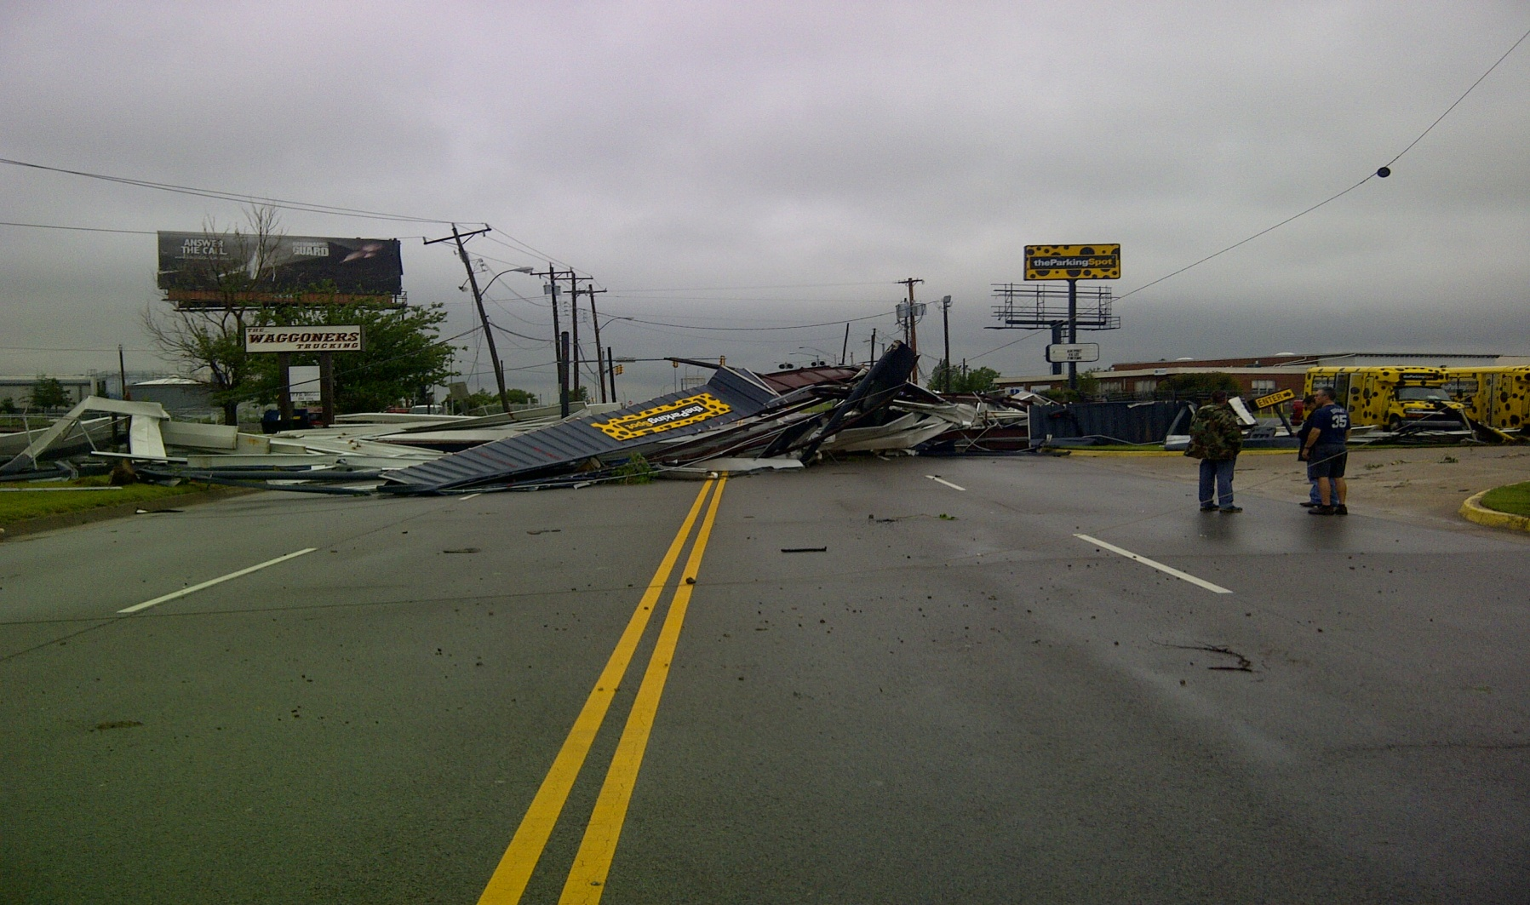
Moore, Oklahoma 1 June

Slide 8
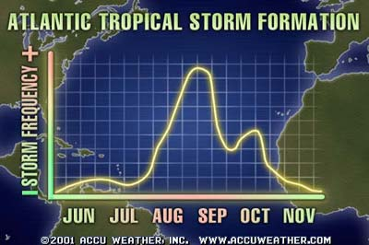
Hurricane Season
The Atlantic Hurricane season runs from 1 June and ends 30 November.
The most active period for the Atlantic Basin (Cape Verde season)
begins mid-August and runs through late September, the peak being
September 10th.
2

Slide 9
NOAA 2013 Hurricane Season Outlook
???Does it Matter???
3

Slide 10
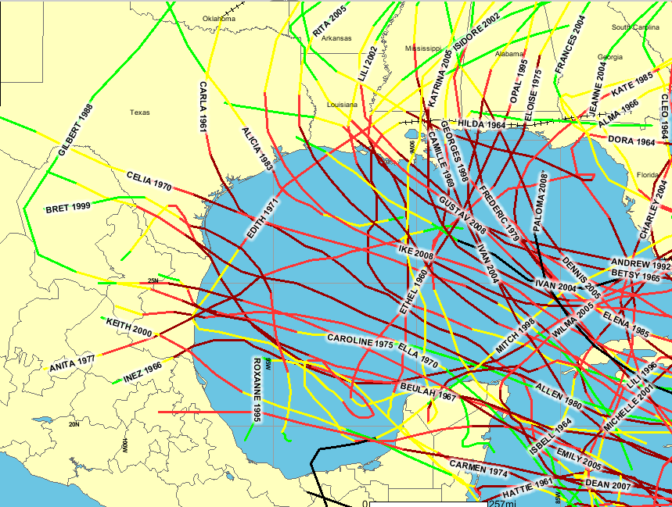
Historical Gulf Coast Strikes
Coastal Strikes 1961-2008
4

Slide 11
National Response Framework
National Disaster Recovery Framework
How the Nation conducts all–hazards response and recovery
Natural disasters, technological emergencies, national emergencies, and terrorism
15 Emergency Support Functions (ESFs) : 6 Disaster Recovery Functions( DRFs)
FEMA coordinates response and recovery support from across Federal Government by calling up as needed one or more ESFs/DRFs
US Army Corps of Engineers (USACE) assigned as coordinator for ESF#3 “Public Works and Engineering”
5
Notes:
How we get involved is through the NRF. FEMA is the lead agency for disaster response activities. USACE receives a Mission by FEMA to assist under ESF#3.

Slide 12
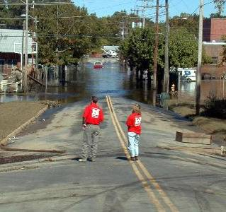
National Response Framework
Emergency Response Functions
ESF #1 - Transportation (Department of Transportation)
ESF #2 - Communications (Department of Homeland Security)
ESF #3 - Public Works and Engineering (Department of Defense
/U.S. Army Corps of Engineers)
ESF #4 - Firefighting (Department of Agriculture/Forest Service)
ESF #5 - Emergency Management (Department of Homeland Security)
ESF #6 - Mass Care, Emergency Assistance, Housing, and
Human Services (Department of Homeland Security)
ESF #7 - Resource Support (General Services Administration)
ESF #8 - Public Health and Medical Services (Department of Health and Human Services)
ESF #9 - Search and Rescue (Department of Homeland Security)
ESF #10 - Oil and Hazardous Materials Response (Environmental Protection Agency)
ESF #11 - Agriculture and Natural Resources (Department of the Agriculture)
ESF #12 - Energy (Department of Energy)
ESF #13 - Public Safety and Security (Department of Justice)
ESF #14 - Long-Term Community Recovery and Mitigation (Department of Homeland
Security)
ESF #15 - External Affairs (Department of Homeland Security)
6

Slide 13
USACE National Response
Framework Missions
Support to Urban Search and Rescue
Water/ Commodities
Temporary Emergency Power
Infrastructure Assessment
Critical Public Facilities
Debris Clearance, Removal and Disposal
Temporary Roofing / Rapid Temporary Repair
Temporary Housing Support
7
Notes:
We have trained teams to executed mission. Teams are located through out US. 6 to 8 teams across US for each mission are.

Slide 14
Hurricane Sandy
http://www.youtube.com/watch?v=DUyp99cS0jw&feature=youtu.be
8

Slide 15
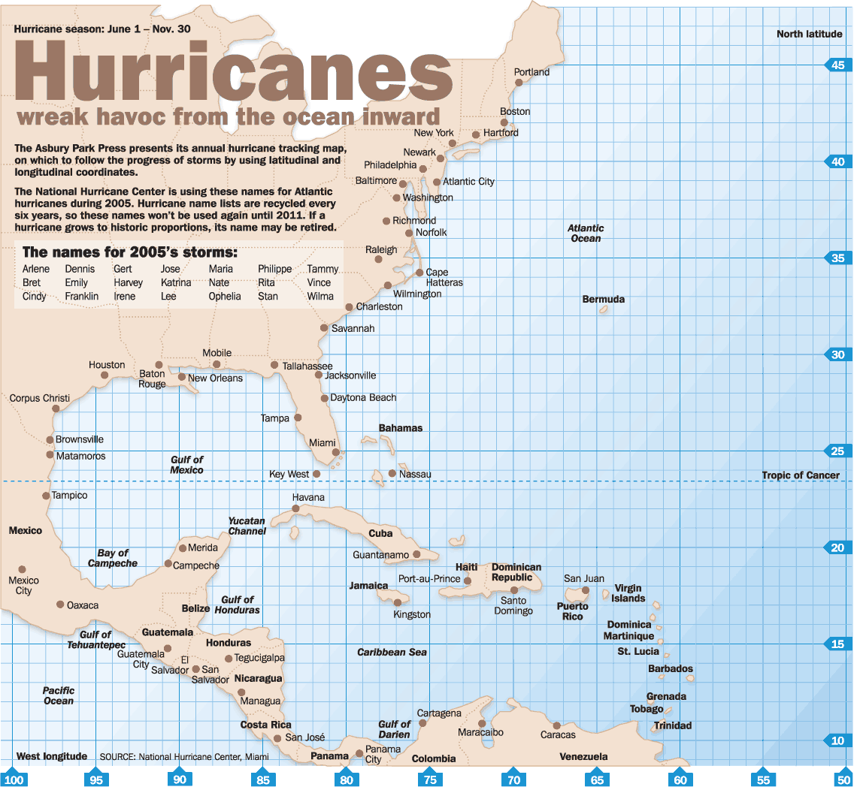

FEMA Region VI Hurricane Trigger Points
United States
TP7
Post
H-Hr
TP6
Incident
H-24
30º
TP5
Incident Response
H-48
Corridor A
TP4
Corridor B
Credible Threat
H-72
TP3
H-96
TP2
25º
Elevated Threat
H-120
TP1
H-Hr
Corridor C
Monitoring
H-144
H-24
Avenue of Approach 2
20º
H-48
H-72
Avenue of Approach 1
15º
H-96
H-120
100º
95º
90º
85º
80º
75º
70º
65º
60º
55º
10º
H-144

Slide 16
Hurricane Madison
Madison Video
10

Slide 17
Discussion
Order of Discussion
    Texas Division of Emergency Management (TDEM)
    Federal Emergency Management Agency (FEMA)
    Southwestern Division (SWD)
      Galveston District (SWG)
      Fort Worth District (SWF)
      Tulsa District (SWT)
    Private Sector Discussion
11

Slide 18


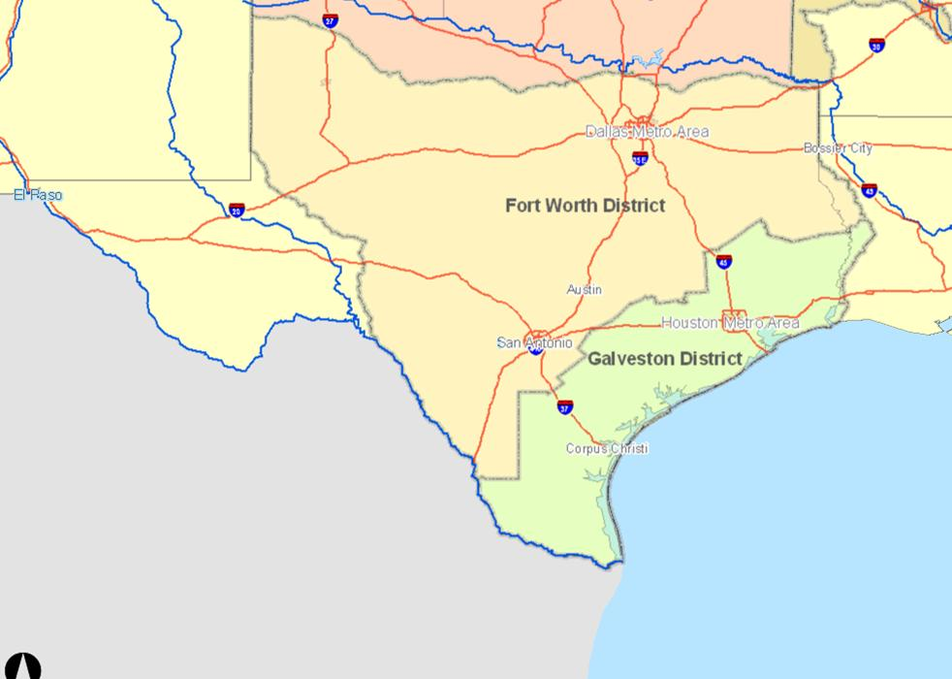



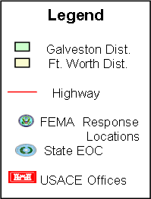
SWD HQ EOC at Level I: Normal Operations Monitor storm track | SWD – Texas Response L-144 Normal Operations (Steady State) |  |  |  | FEMA R6 Steady State Monitory storm track
Galveston District EOC at Level I: Normal Operations Monitor storm track |  | Fort Worth District EOC at Level I: Normal Operations Monitor storm track | Tulsa District EOC at Level I: Normal Operations | Little Rock District EOC at Level I: Normal Operations
Tulsa District (SWT)
FEMA VI
FEMA NRCC
HQ USACE
Washington, DC
Little Rock District (SWL)
Fort Worth District (SWF)
Southwestern Division (SWD)
Texas Division of Emergency Management (TDEM)
TDEM
Monitors storm track
Galveston District (SWG)
L-144 – Steady State
12

Slide 19
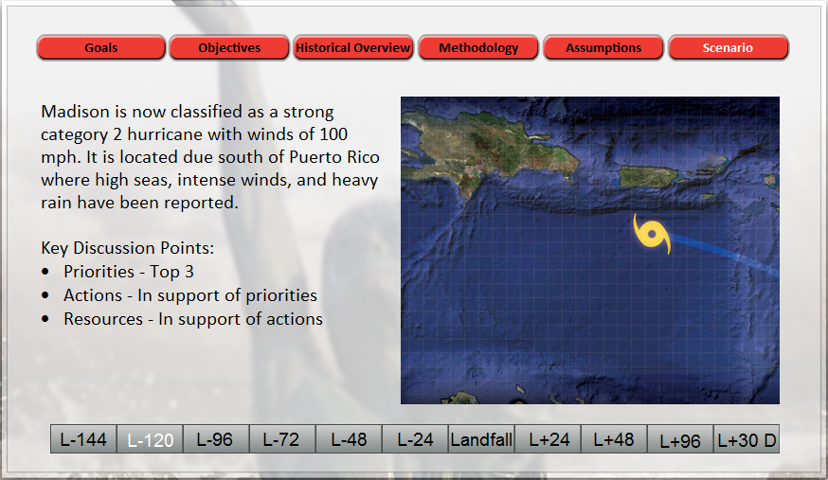
13

Slide 20

SWD HQ SWD continues to Monitor storm track. Initiates Regional Calls with SWG EOC. SWD EOC at Level I : Normal Operations Participate on conference calls with HQUSACE, FEMA and TDEM. BPT Deploy ESF#3 TL/ATL to RRCC and IOF (IMAT) as directed by FEMA | SWD – Texas Response L-120 – L-96 Normal Operations (Monitoring) |  |  |  | FEMA R6 RRCC Activates; Alerts specific ESFs Coordinate Regional Conference Calls Alert and deploy Incident Management Assistance Team (IMAT) to Austin SOC. Pre-dec MAs (Power/Commodities)
Galveston District EOC activated - to Level II: (Emergency Watch) Monitor Storm track and prepare for potential Texas Coast Strike Be prepared for a Texas Strike BPT request to deploy SWF for potential handoff of FEMA Missions BPT request Commodities team replacement BPT request additional teams per Pre-dec MA. |  | Fort Worth District EOC at Level I: Normal Operations (Monitoring) Monitor situation and provide updates to Command Staff, EOC cadre, Debris PRT and RRV06 team. BPT deploy ADVON Team to San Antonio for potential mission transition from SWG. Verify Debris ACI contracts. Coordinate with SWG. | Tulsa District EOC at Level I: Normal Operations (Monitoring) Monitor Storm track and prepare teams for potential deployment BPT deploy Power PRT Management Cell to IOF as required. Notify Pittsburg District of potential power mission. Verify ACI contracts and 249th and Power Team movements. | Little Rock District EOC at Level I: Normal Operations (Monitoring) Monitor Storm track and prepare teams for potential deployment BPT deploy Temporary Roofing Management Cell to IOF as required.
HQ USACE OFFICES
Washington, DC
FEMA NRCC
NRCC Activated
ESF #3 TL/ATL
National Ice and Water AO
FEMA VI
RRCC Activated
SWT
SWF
SWL
TXDEM SOC
SWD
Level I - Monitoring
FEMA VI IMAT
TDEM
Monitors storm track
Conducts Regional Calls
Elevate SOC Level
Request IMAT
SWG
Level II – Emergency Watch
L-120 – L-96
Phase 1a – Monitoring
14

Slide 21
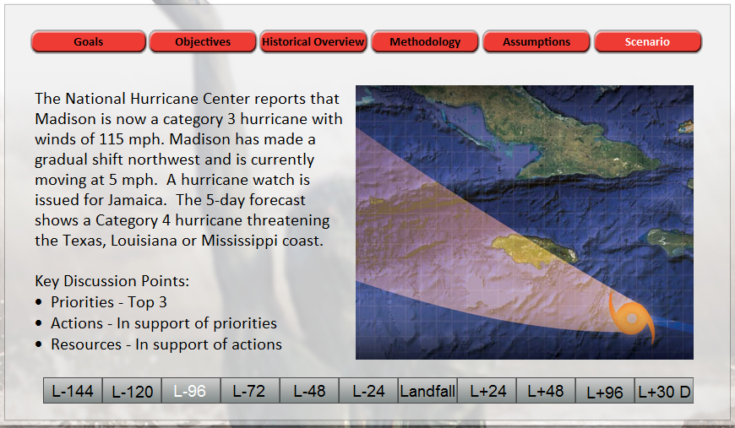
15

Slide 22
SWD HQ Coordinate Deployment of Power/Commodities PRT to FEMA ISB Elevate EOC to Level II: Emergency Watch or Level III If required, SWD TF Pacesetter to State EOC/IOF Deploy assets to ISB, OIF, Area Office prior to landfall | SWD – Texas Response L-96 – L-48 Phase 1: Activation Phase Phase 2: Deployment Phase |  |  |  | FEMA R6 RRCC activated to Level 2. (24/7) Coordinate with Texas on Pre-Landfall declaration request. Pre-position personnel and equipment for rapid response Alert and deploy remaining ESFs to RRCC. Request USACE Hurricane Models for potential impact Coordinate commodities and generators arrival at ISB Randolph.
Galveston District EOC remains at Level III: (partial staffing extend hours 18/7) continue monitoring and providing situational updates. Prepare forecasts on flooding, overtopped flood protection projects, projected reservoir levels and release rates in affected areas (H&H) BPT transition FEMA MA execution to SWF. Deploy ADVON (8-10 PAX) forward (or to COOP Site) |  | Fort Worth District EOC elevated to Level II: Emergency Watch. Continue to monitor and provide updates to command staff. Continue coordination with SWG SWF District Commander goes to San Antonio AO in the event Galveston is impacted. Be prepared to assume lead from SWG. | Tulsa District EOC at Level II: Emergency Watch. On order deploy Power PRT to ISB On order SWT Commander deploys to ISB. (Power) Perform EM-dec power mission assignments. | Little Rock District EOC at Level II: Emergency Watch. On order deploy SWL PRT and ESF 3 Cadre. On order SWL Commander deploys to IOF in Austin. (Commodities). On order Continue preparing roofing PRT QAs for potential deployment.
HQ USACE OFFICES
Washington, DC
FEMA NRCC
ESF #3 TL/ATL
National Ice and Water AO
SWT
EOC Level II
FEMA VI
RRCC Activated
ESF #3 TL and ATL
SWF
EOC Level II
SWL
EOC Level II
SWD
EOC Level III
TXDEM SOC
PL 84-99 LNO SWF
PL 84-99 LNO SWG
SWG
EOC Level III
IOF
FEMA VI IMAT
ESF #3 TL/ATL
C2 249TH EN BN
Power Mgt Cell
Debris Mgt Cell
Commoditis Mgt Cell
Roofing Mgt Cell
Housing Mgt Cell
TF Pacesetter
TDEM
EOC elevated to Level I
Begin evacuation contra-flow
Request pre-landfall dec
ISB Randolph (Seguin)
FEMA Logistics
Power PRT
Commodities PRT
249th minus Mgt Cell
ECCV 6 (SWF)
SWL Commodities Czar
SWT Power Czar
Area Office
SWF District CDR
TF Fort Worth
L-96 – L-48
Phase 1b. Elevated Threat - Phase 1c Credible Threat
16

Slide 23
BREAK

Slide 24
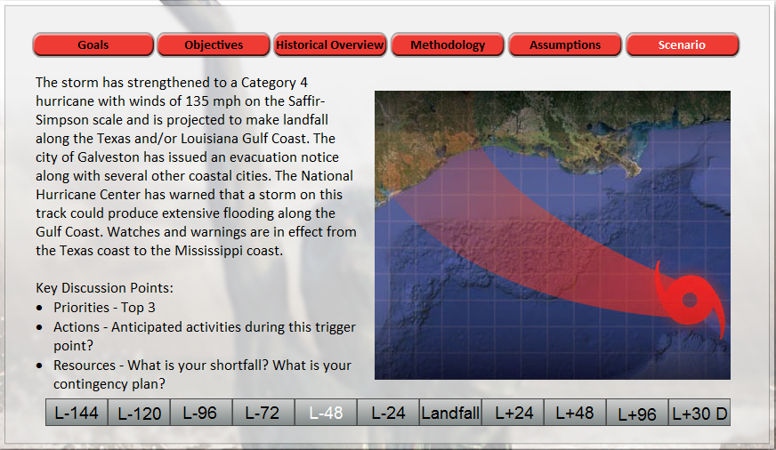
17

Slide 25
SWD HQ EOC elevated to Level III: Partial Activation or Level IV: Full Activation EOC Staff augmentation required. Refine post-incident response plans based on improved cone of error Refine forecasts of projected flooding, overtopped flood protection projects, projected reservoir levels and release rates Coordinate FEMA MA transition from SWG to SWF | SWD – Texas Response L-48 – Landfall Phase 3: Execution Phase |  |  |  | FEMA R6 RRCC activated to Level 1. (24/7) Awaiting Hurricane Landfall Refine post-incident plans based on improved cone of error Issue additional MAs, Debris, Roofing, USR
Galveston District EOC elevated to Level IV (full activation, 24/7), continue monitoring and providing situational updates. Readiness Condition 1 (EVACUATION) Relocate CMT and CAT to COOP Transition FEMA MA execution to SWF. Continue to prepare forecasts on flooding, overtopped flood protection projects, projected reservoir levels and release rates in affected areas (H&H) |  | Fort Worth District EOC elevated to Level IV:(Full staff 24/7) to support response operations. Continue to monitor and provide updates to command staff. Continue coordination with SWG Close project offices and construction sites in projected path of hurricane. Receive FEMA MA roles for SWG. Awaiting Hurricane Landfall | Tulsa District EOC remains at Level II: Emergency Watch. Awaiting Hurricane Landfall Prep Power PRT for Jump from ISB (Randolph AFB) to down range ISB. | Little Rock District EOC elevated to Level II (Emergency Watch) potential flood event in AOR. Awaiting Hurricane Landfall Continue preparing roofing PRT QAs for potential deployment.
SWT
EOC activated
FEMA VI
RRCC Activated
ESF #3 TL and ATL
HQ USACE OFFICES
Washington, DC
FEMA NRCC
ESF #3 TL/ATL
National Ice and Water AO
SWF
EOC Activated
SWL
EOC activated
TXDEM SOC
PL 84-99 LNO SWF
PL 84-99 LNO SWG
SWG COOP (Addicks-Barker)
6-8 ADVON (SWG)
Commodities ML
Power ML
Main Body (T)
Navigation Team (5-7)
SWD
EOC activated
IOF/JFO
FEMA VI IMAT
ESF #3 TL/ATL
C2 249TH EN BN
SWF Battle Cpt
Power Mgt Cell
Debris Mgt Cell
Commoditis Mgt Cell
Roofing Mgt Cell
Housing Mgt Cell
TF Pacesetter
TDEM
Awaiting Hurricane Landfall
Refine post-incident plans based on improved cone of error
ISB Randolph (Seguin)
FEMA Logistics
SWF Battle Captain
Power PRT
Commodities PRT
249th minus Mgt Cell
ECCV 6 (SWF)
SWL Commodities Czar
SWT Power Czar
L-48 - Landfall
Area Office
SWF District CDR
TF Fort Worth
Phase 2. Incident Response Phase
18

Slide 26
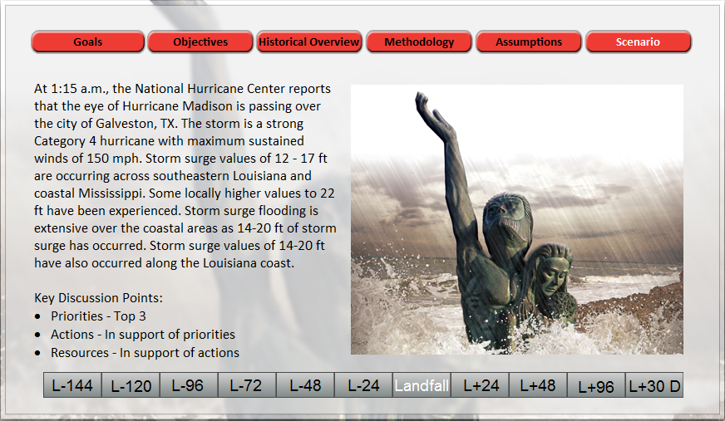
19

Slide 27
SWD HQ Facilitate Battle handoff from SWF to SWG. On order BPT Deploy Dam and Levee Safety SMEs in support of district operations and/or flood-fight. Review approve water control deviations. (As required) Continue to provide ESF#3 support to FEMA 6 and the JFO. Coordinate additional response assets with HQUSACE. | SWD – Texas Response Landfall + Phase 4: Recovery Phase |  |  |  | FEMA R6/JFO RRCC handoff to JFO and returns to normal operations. JFO provides response and recovery assistance. Issue Post-Dec MAs.
Galveston District Reconstitute back to SWG HQ Establish RFO as directed by FEMA Mission Assignment Assess impacts to SWG personnel and facilities. Reconstitute evacuated staff, repair damaged facilities. Assess impacts to project offices and construction sites in path of hurricane. Repair/recover as requried. Transition FEMA MA execution back from SWF. Conduct post-landfall flights to assess hurricane impacts.. |  | Fort Worth District EOC remains to Level IV:(Full staff 24/7) . Transition FEMA MA execution back to SWG. Sustain Debris PRT operations. Submit USACE project damage assessments, flooding, reservoir status and levee status, to SWD. Deploy QA volunteers and RFO staff as necessary to meet new requirements and/or replace personnel. Transition to Post-dec funding. | Tulsa District EOC elevated to Level III (partial staff 12/7) potential flood event in AOR. Submit USACE project damage assessments, flooding, reservoir status and levee status, to SWD. Deploy QA volunteers and RFO staff as necessary to meet new requirements and/or replace personnel. Transition to Post-dec funding. | Little Rock District EOC remains at Level III (partial staff 12/7) potential flood event in AOR. Submit USACE project damage assessments, flooding, reservoir status and levee status, to SWD. Deploy QA volunteers and RFO staff as necessary to meet new requirements and/or replace personnel. Transition to Post-dec funding.
HQ USACE OFFICES
Washington, DC
FEMA NRCC
ESF #3 TL/ATL
National Ice and Water AO
FEMA VI
SWT
SWL
SWD
TXDEM
SOC activated
TDEM
Coordinate with FEMA to fulfill unmet needs.
Conduct Joint PDAs
Establish Regional and Local Staging Areas in impacted area.
Initiate operation of State and local recovery
JFO
FEMA FCO
ESF #3 TL/ATL
249TH C2
Power AO
Debris AO
Commodities AO
Roofing AO
TF Pacesetter
ESF #3 TL HQ
ESF #3 LNO (SWG)
SWL District CDR
ESF #15 PAO PRT
ESF #3 ATL (3)
SWF
SWG
RFO
SWG District CDR
RFO ADVON
RFO Main Body
Roofing PRT
Debris PRT
Housing PRT
ECCV 6 (SWF)
Power ML
2 Battle CPT
DAM Safety SME
EERT
ACE-IT MM
AARK Kit (ERDC)
LPRT
Down Range ISB
SWT Power Czar
SWL Commodities Czar
Power PRT
Commodities PRT
249th minus Mgt Cell
2 ECCV
Landfall +
Phase 3. Post Incident
20

Slide 28
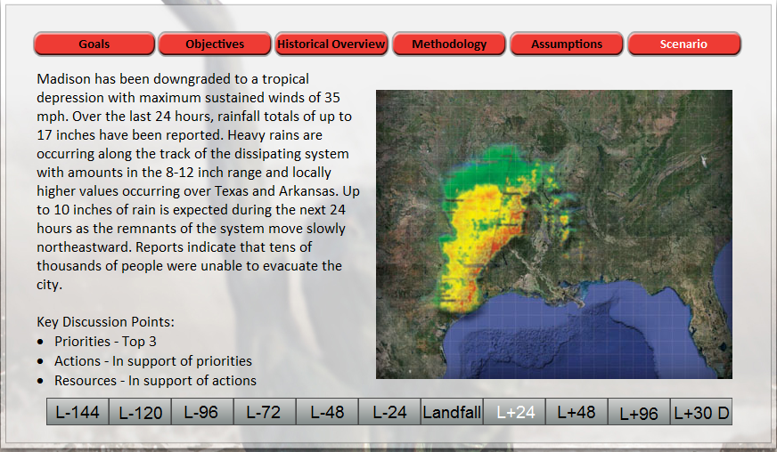
21

Slide 29
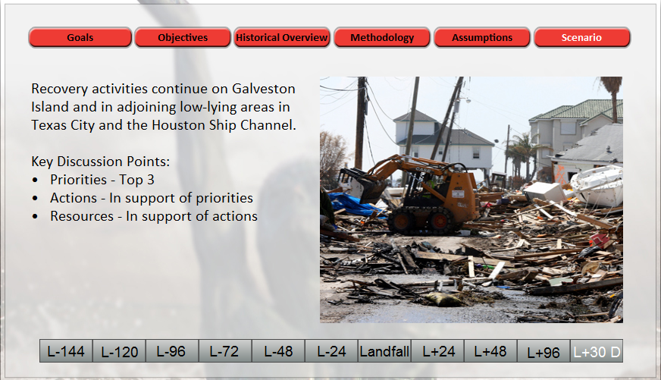
Recovery activities continue on Galveston Island and in adjoining low-lying areas in Texas City and the Houston Ship Channel.
The Remnants of Hurricane Madison has also impacted Northeast Texas with area flooding and flash floods as it moves into Arkansas as the Federal and State agencies continue to provide emergency response and long term support to their communities that were impacted.
Key Discussion Points:
Priorities - Top 3
Actions - In support of priorities
Resources - In support of actions
22

Slide 30
SWD HQ Return to Level 1: Normal Ops Monitor physical and fiscal closeout of mission assignments. coordinate reconstitution of damaged USACE facilities. Support contract close-out. Prepare to transition to Long Term Recovery MA as required | SWD – Texas Response Phase 5 Close out |  |  |  | FEMA R6 Determine completion of mission assignment and deactivates USACE assets. Send out mission assignment close out letters as needed. Coordinate for Long Term Mission Steady State
Galveston District EOC returns to Level 1: (Normal Ops) support response. Prepare RFO for mission closeout Review and approve all close-out and transition plans for FEMA mission. Assess impacts to project offices and construction sites in path of hurricane. Repair/recover as required. Provide AAR comments to SWD. Prepare to assume Long Term Recovery Mission as directed by FEMA |  | Fort Worth District EOC returns to Level 1: (Normal Ops) support response. Prepare Debris mission closeout. Deploy QA volunteers and RFO staff as necessary to meet new requirements and/or replace personnel. Provide AAR comments to SWD. | Tulsa District EOC returns to Level 1: (Normal Ops) support response. Prepare Power mission closeout. Deploy QA volunteers and RFO staff as necessary to meet new requirements and/or replace personnel. Provide AAR comments to SWD | Little Rock District EOC returns to Level 1: (Normal Ops) support response. Prepare Temporary Roofing mission closeout. Deploy QA volunteers and RFO staff as necessary to meet new requirements and/or replace personnel. Provide AAR comments to SWD
FEMA VI
HQ USACE OFFICES
Washington, DC
FEMA HQ
Washington, DC
SWT
SWF
SWL
SWD
TXDEM
SWG
TDEM
Request Long Term Recovery Mission as required.
Return to Level III
48 + (Long Term Recovery)
Phase 3. Post Incident
23

Slide 31

Oklahoma tornado deaths include three veteran storm chasers
Tim Samaras & Carl Young
34

Slide 32
USACE Contract Registry
24

Slide 33
Contracting Opportunities
Contract for mission execution and support
  Temporary Roofing (ACI)
  Debris Removal (ACI)
  Emergency Power (ACI)
  Temporary Housing
  Quality Assurance Inspectors
  Water
  Infrastructure/Structural Inspectors
HQ USACE contractor registration web page:
https://apps.swf.usace.army.mil/hurricane/
Corps of Engineers Disaster Resource contractor Registry located
on the Corps of Engineers Emergency Response Portal:
https://eportal.usace.army.mil/sites/ENGLink/default.aspx
25
Notes:
We use contracts to execute much of our response missions for FEMA. If interested you can register at the Corps Emergency response portal.

Slide 34
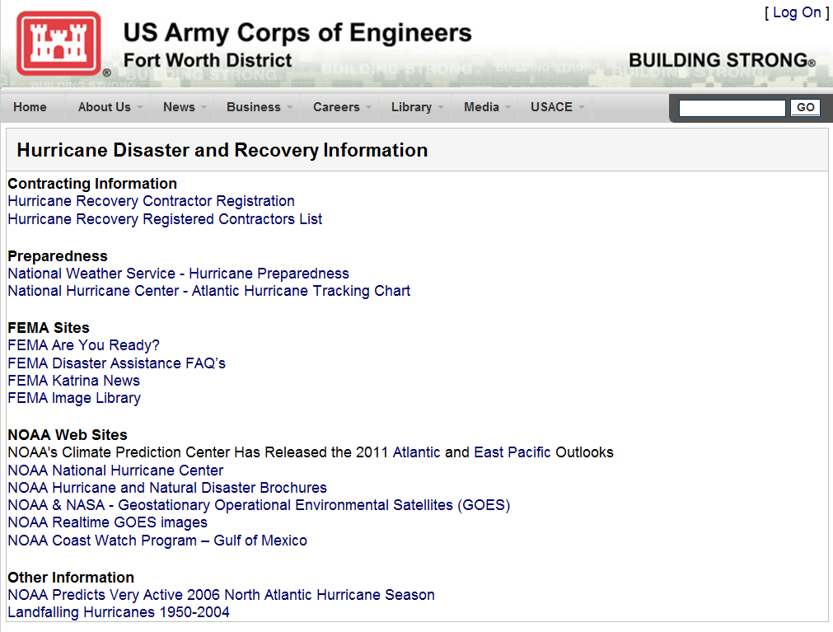
Contracting Registry Website
https://apps.swf.usace.army.mil/hurricane
Contractor Registration Link
25

Slide 35
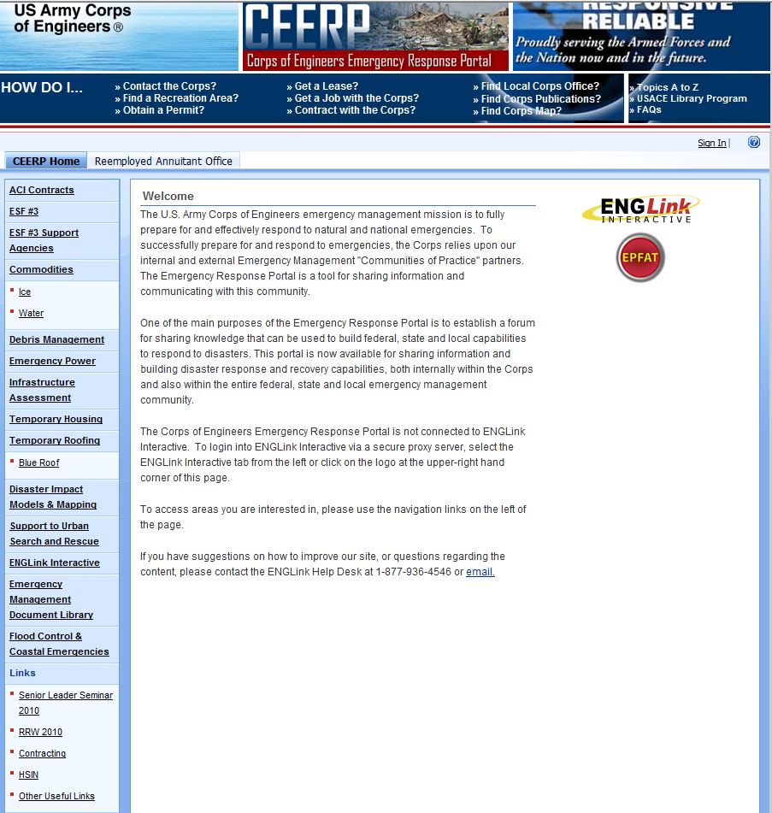
Disaster Resource Contractor Registry
https://eportal.usace.army.mil/sites/ENGLink/default.aspx
Contractor Registration Link

Slide 36
Division and Proponent POC
Ice/Water POC: Duban Montoya, NAD, 978-318-8086
National Water
Roofing POC: Tom Murrell, NWD, 314-331-8787
Temporary Roofing
Emergency Power
Power POC: Dave Bishop, LRD, 724-459-4709
Northwestern Div
North Atlantic Div
Mississippi Valley Div
San
Francisco
Infrastructure Assessment
Great Lakes &
Ohio River Div
South Pacific Div
Los
Angeles
Commodities
South Atlantic Div
Southwestern Div
National Ice Temp Housing
Pacific Ocean Div
Debris Removal
Debris POC: Jim Garner, MVD, 601-634-7970
27

Slide 37
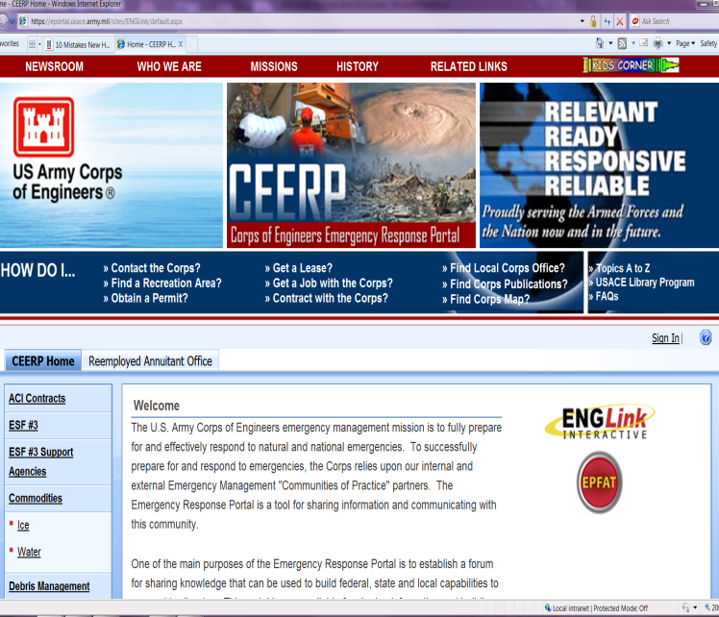
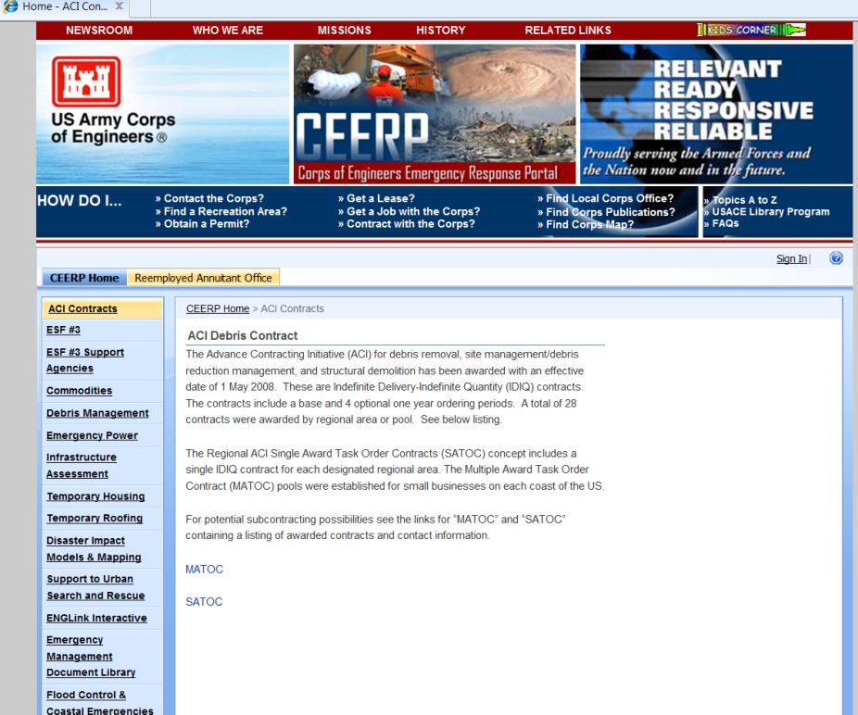
https://eportal.usace.army.mil/sites/ENGLink/default.aspx
28

Slide 38
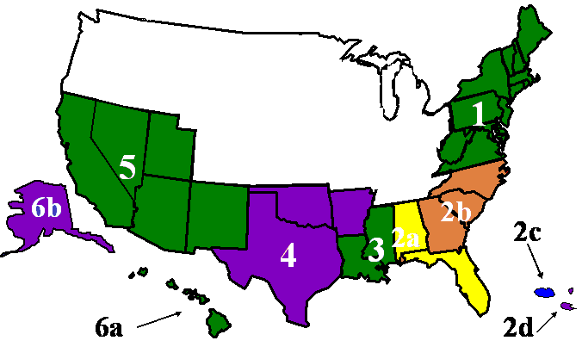
Debris Advance Contracting Initiative
Debris ACI Contractors
  Immediate response
  Maximum local hiring and subcontracting
  Pricing (known & stable)
  Costs reduced
  Partners with Private Sector
  Improves performance
  Standardizes contracts
ECC
P & J
Ceres
AshBritt
Xperts
29

Slide 39
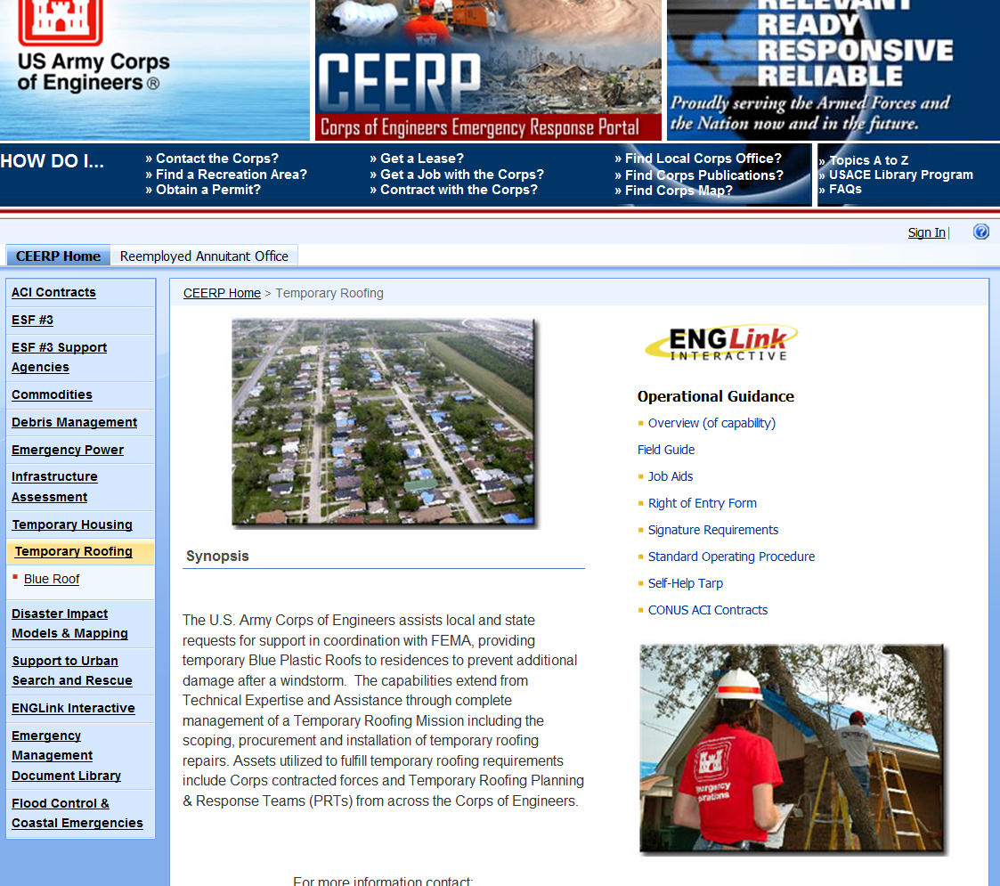
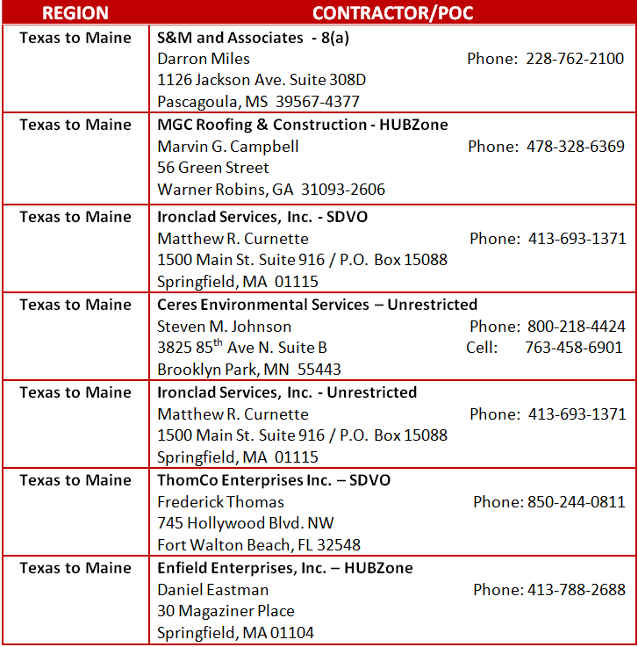
https://eportal.usace.army.mil/sites/ENGLink/default.aspx
30

Slide 40
Roofing Advance Contracting Initiative
Temporary Roofing ACI Contractors
Northwestern Div
North Atlantic Div
Great Lakes &
Ohio River Div
South Pacific Div
San
Francisco
Los
Angeles
South Atlantic Div
Mississippi Valley Div
Southwestern Div
Pacific Ocean Div
31

Slide 41
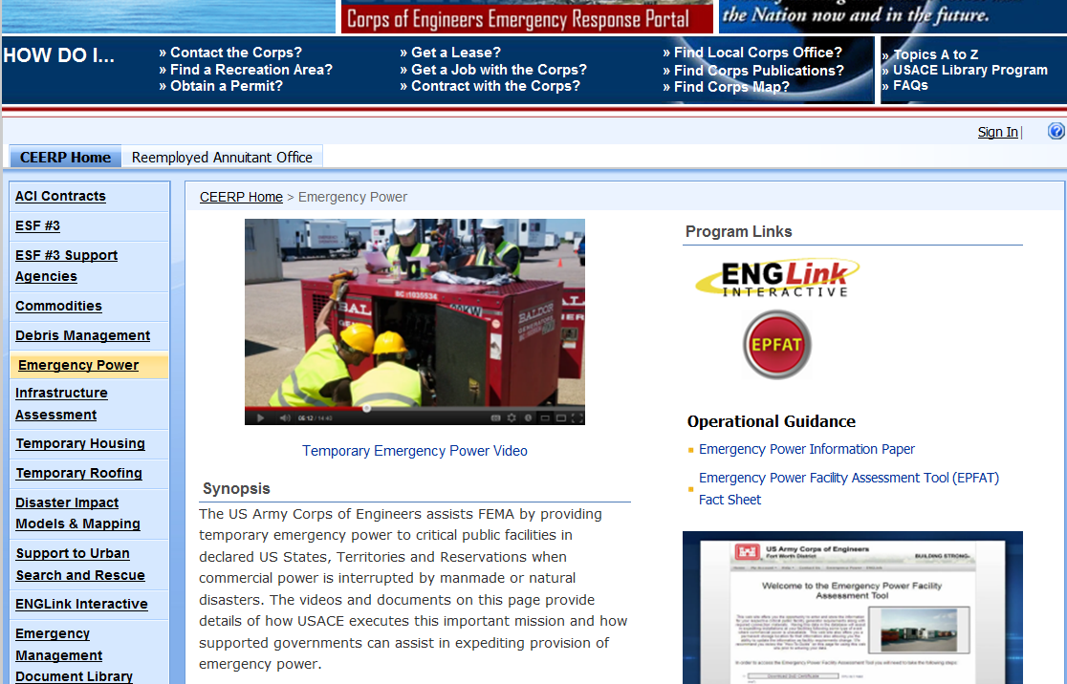
https://eportal.usace.army.mil/sites/ENGLink/default.aspx
32

Slide 42
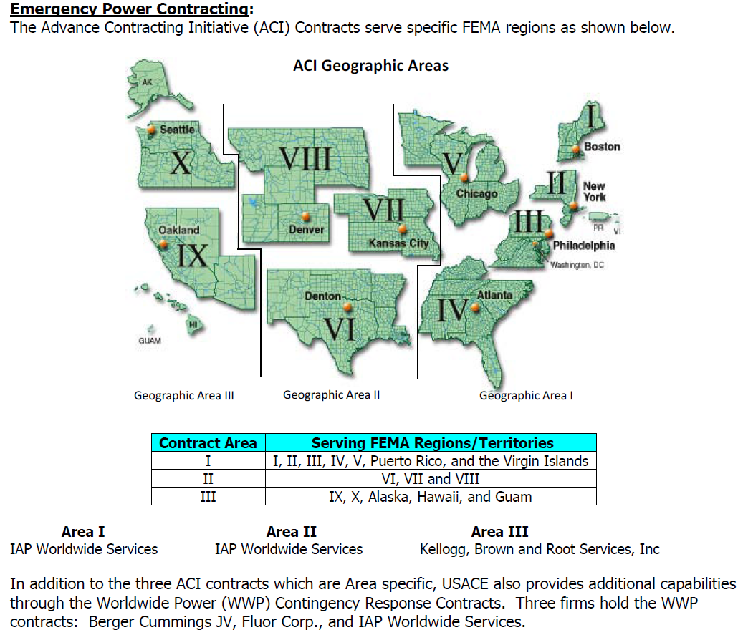
33

